Slide 1
Capturing our carbon footprint
Dr JMT Pierce
Environmental Advisor
Royal College of Anaesthetists

Slide 2
Calculating the CO₂e of nitrous oxide
Medical gases supplied as volumes at 15C
  Nominal filling weight
  Universal gas equation to calculate the mass of cylinder contents
Nitrous oxide/oxygen 50:50 mixtures
    57.9% of the mass is nitrous oxide
IPPC AR5 GWP₁₀₀ 295
  Mass of nitrous oxide x GWP = CO₂e
    Size E 3.4 kg x 295 = 1003 kg CO₂e

Slide 3
Calculating the CO₂e of volatile agents
Volume x density = mass
GWP₁₀₀
  Sevoflurane 140
  Isoflurane 510
  Desflurane 2540
CO₂e per bottle
  Sevoflurane 49 kg
  Isoflurane 197 kg
  Desflurane 893 kg

Slide 4
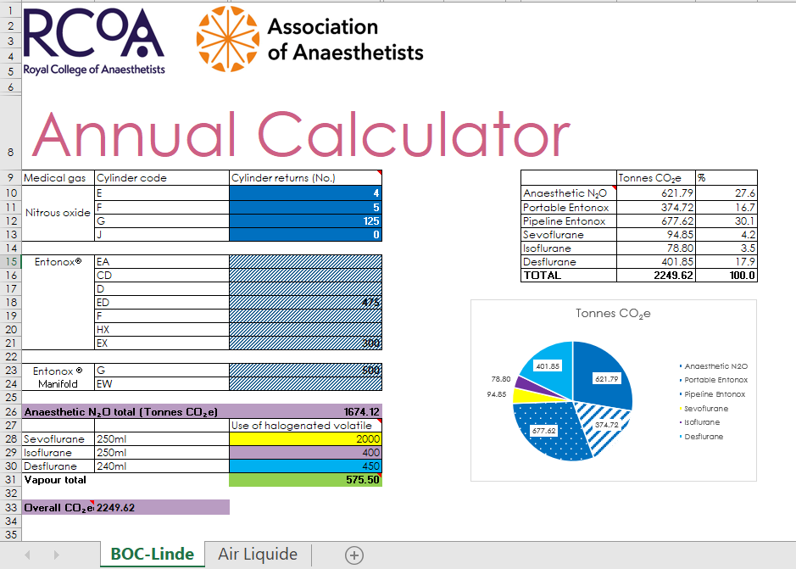
Notes:
Cylinder size, know the numbers returned, know the mass then calculate the CO2e

Slide 5
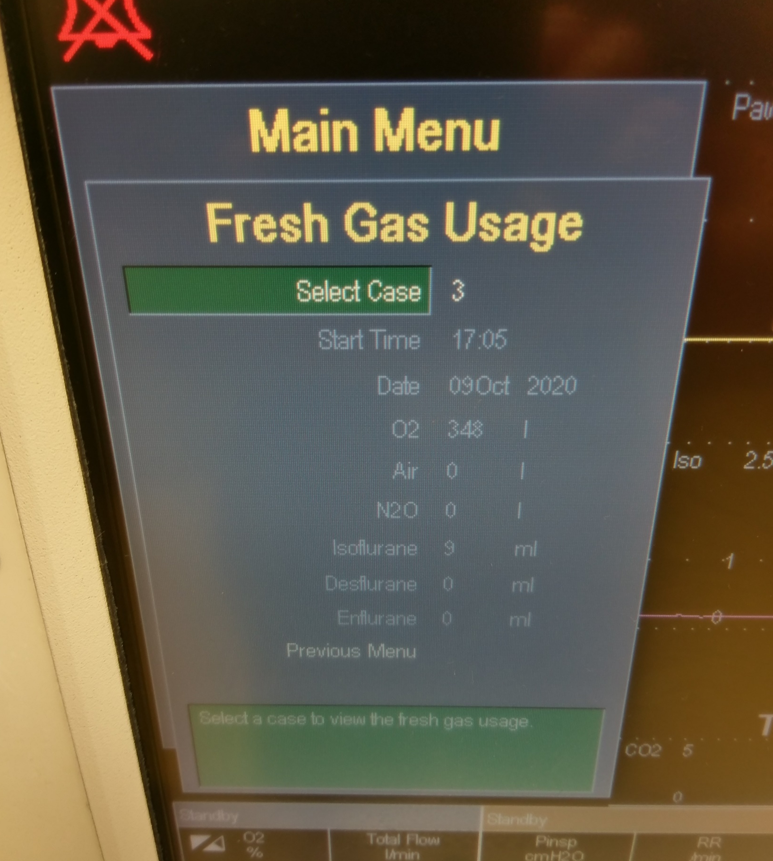
Fresh gas usage (GE machines)
9 ml isoflurane
Equivalent to
7.1 kg CO₂e

Slide 6
Real time calculator
FGF and the composition
Volatile agent concentration
  Volume of volatile vapour per unit time
  Know the molecular weight
  Apply Avogadro's hypothesis assume ideal gas
    Calculate the mass of volatile used per unit time
    Derive the CO₂e of an hour’s anaesthesia

Slide 7
Pierce and Taylor Anaesthesia 2020

Slide 8
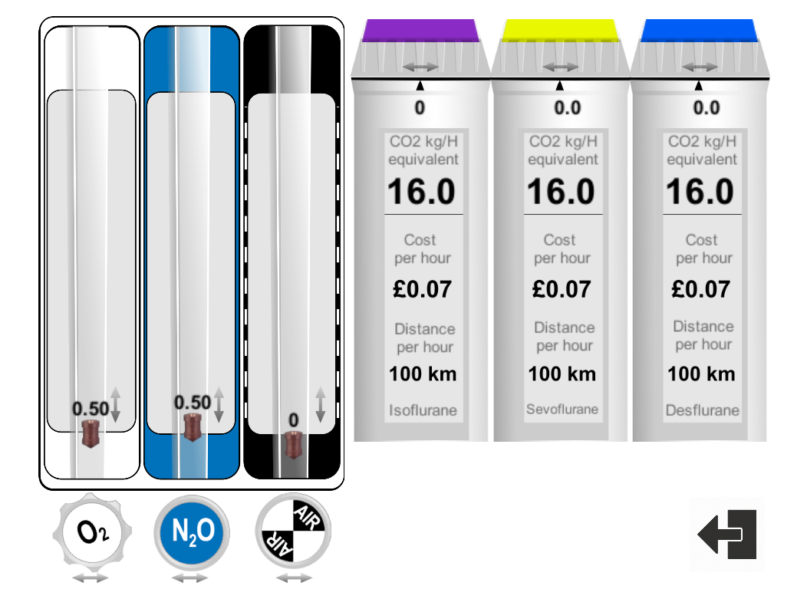
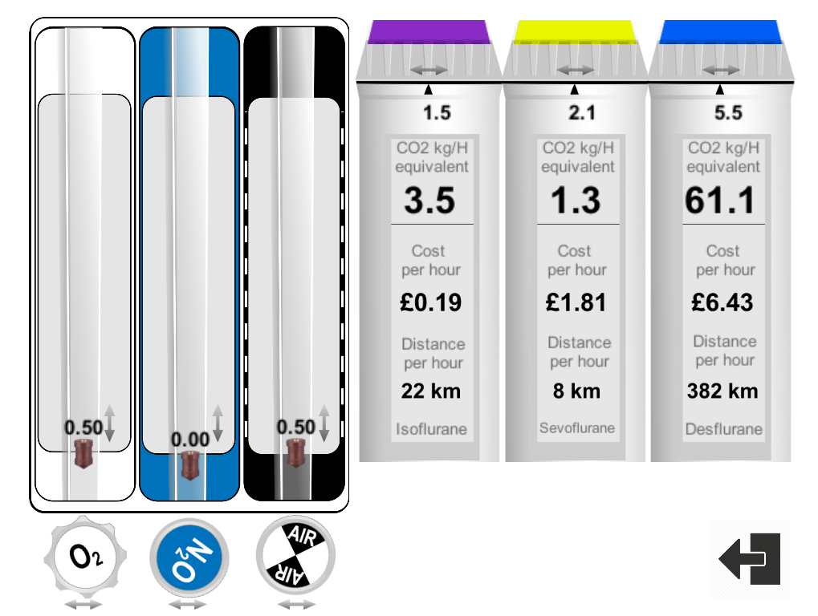
Anaesthetic Impact Calculator
Notes:
Aladin cassette

Slide 9
A calculation of the CO₂e of anaesthesia for TKR
More than just the volatile and nitrous oxide
Ignored the CO₂e of procurement
  Not under anaesthetists’ control
  Mass and number of items is
Duration of surgery 2 hours and weekly theatre utilisation
Personal commuting
Anaesthesia related electrical energy use
Itemise single use items, calculate total mass
Vapour and i.v. drug use
Waste management at end of life

Slide 10
Step changes in anaesthesia for TKR
Desflurane in oxygen air low flow anaesthesia and IPPV
Isoflurane in nitrous oxide/oxygen/ low flow anaesthesia and IPPV
Sevoflurane in oxygen/air low flow anaesthesia and IPPV
TIVA propofol / remifentanil and IPPV
Spinal anaesthesia with 2l/min F/M oxygen
Reduce electrical energy use
AGSS off out of hours
Change waste management
Recycle steel, PET recycled, waste goes to an energy from waste facility
Change commuting practice
SUV to bicycle

Slide 12


Slide 13
Capturing our carbon footprint to build a road map
Pick the low hanging fruit
  Nitrous oxide and desflurane
    Catalytic cracking of nitrous oxide and vapour capture technology
Nuanced approach
  Consider the whole of the care pathway
  Use less stuff
    Less replication (time)
    Less travelling and fuel
    Less electricity and energy
    Less (mass of) drugs
    Less single use items
Win-win

Slide 16
Derived from data supplied by P Henrys
Notes:
14 T anaesthetic nitrous oxide per anaesthetist. = 14 year’s worth of commuting per year

