Slide 1
The NAP5 Activity Survey
Mike Sury
September 2014

Slide 2
Previous estimates of activity
NAP4 estimated the number of general anaesthetics
~ three million (2,872,600) per year

Slide 3
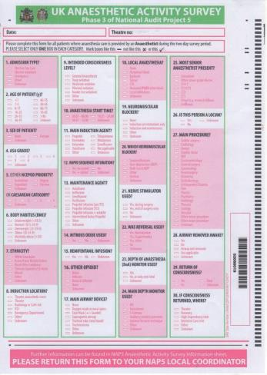


Data collection methods

Slide 4
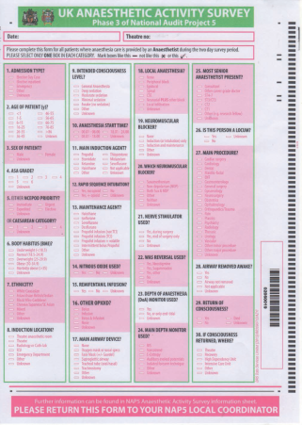
Data collection methods
Every patient over 2 days in September 2013
Only NHS patients in NHS hospitals
Any surgical, diagnostic or interventional procedure where an anaesthetist (of any grade) was responsible for patient care
Any location (ICU, ED, Radiology, Delivery Ward)

Slide 5
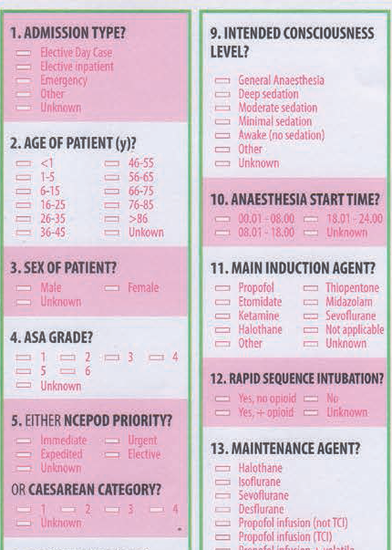

Slide 6
Calculations
Scaling factor from 3 components:
conversion of two days to a week (3.5)
the number of working weeks in 2013 (50.59)
median return rate from LCs (0.98)
(3.5 x 50.59)/0.98 = 180.68
Annual caseload estimations were rounded to the nearest 100.
NB an estimated annual caseload of 200 or 400 represents 1 or 2 returns respectively
All calculations were made using Microsoft Excel 2010 and the ‘PivotTable’ facility.

Slide 7
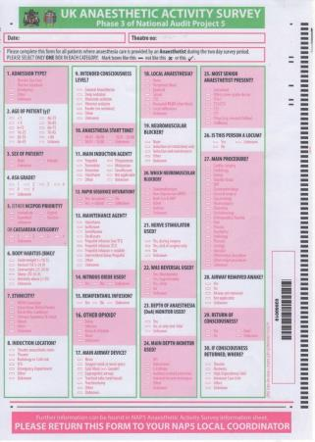
Results
20,400 forms were returned = annual caseload of 3,685,800
Unanswered questions
Overall <4%
2 questions >20%
Which neuromuscular blocker was used?
Main depth monitor used?

Slide 8
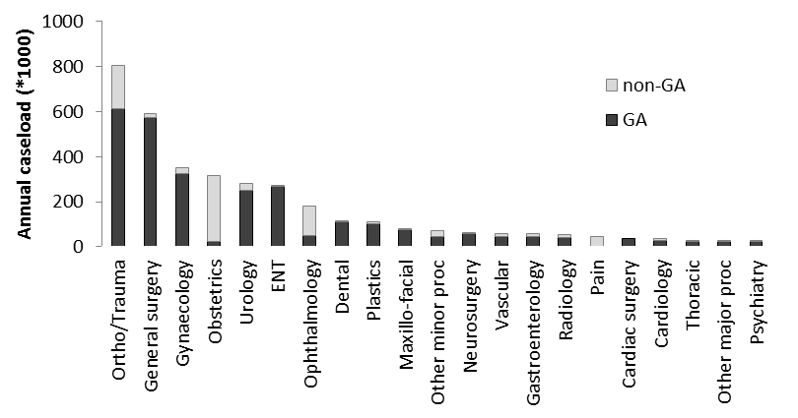
Main procedure

Slide 9
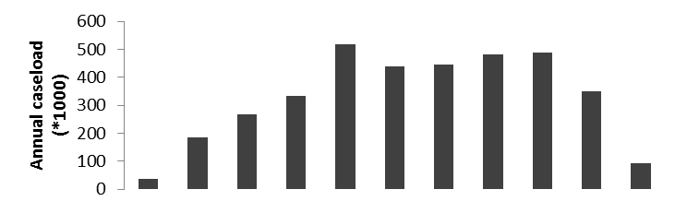
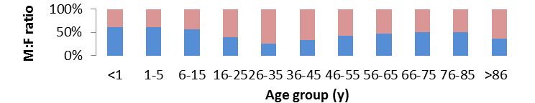
Age and sex

Slide 10
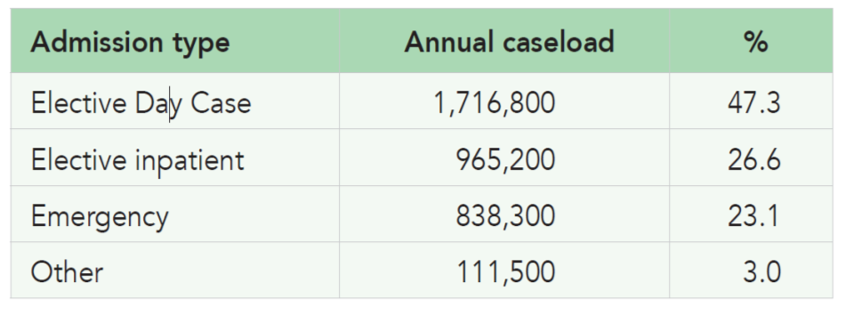
Admission type

Slide 11
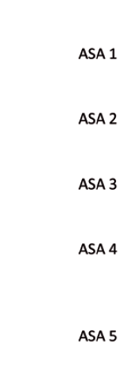
Time of day

Slide 12
Time of day

Slide 13
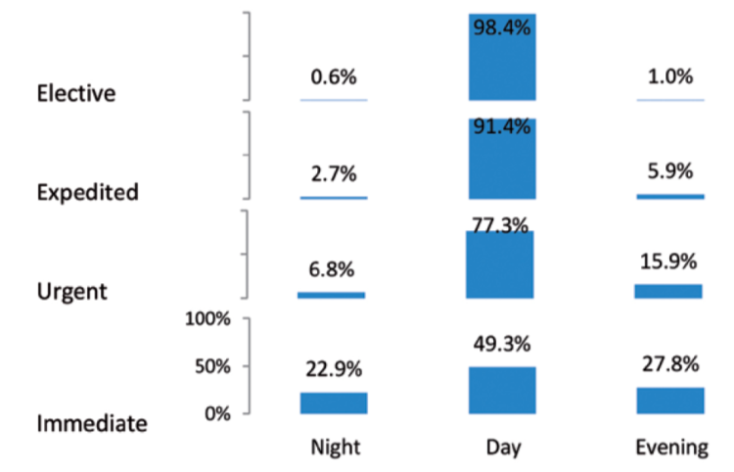
Time of day

Slide 14
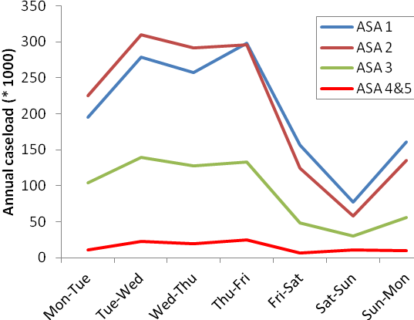
Day of week & ASA

Slide 15
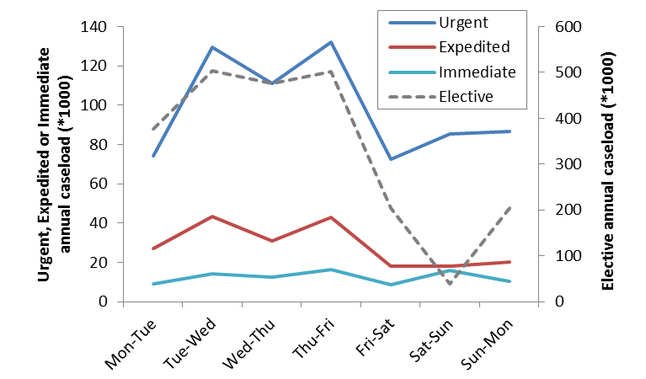
Day of week & Urgency

Slide 16
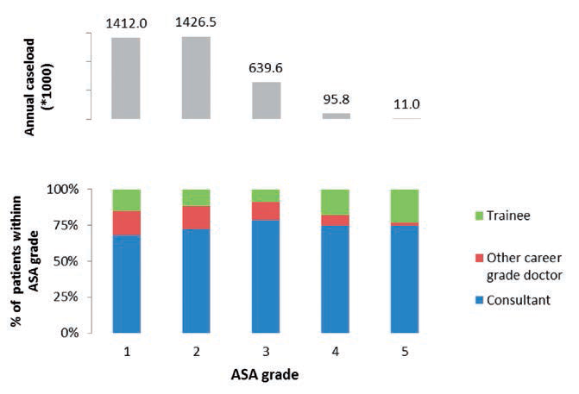
Seniority of Anaesthetist

Slide 17
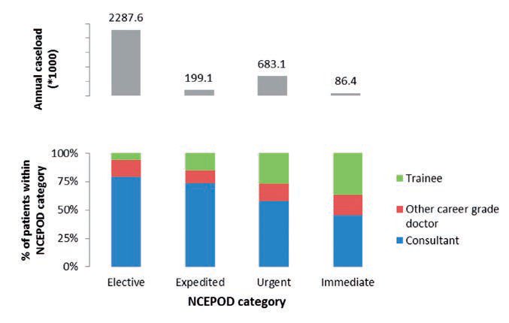
Seniority of Anaesthetist

Slide 18
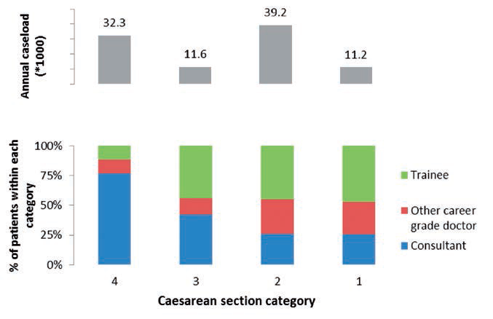
Seniority of Anaesthetist

Slide 19
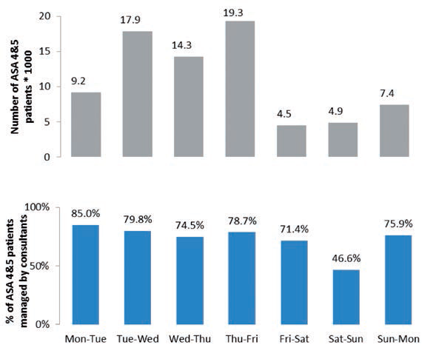
ASA 4 & 5

Slide 20
Intended Conscious level (LOC)
GA | 2,766,600 | 76.9%
Sedation (of any level) | 308,800 | 8.6%
Awake | 523,100 | 14.5%

Slide 21
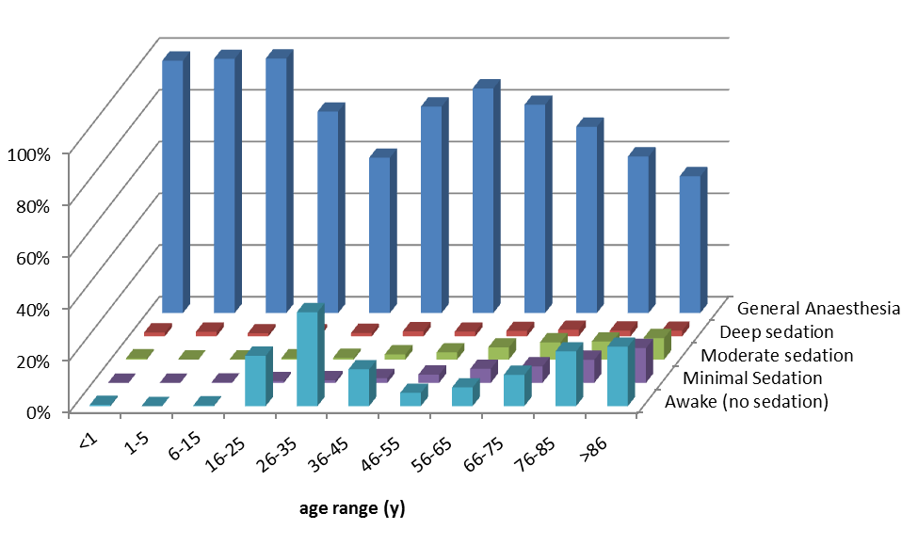
Intended LOC

Slide 22
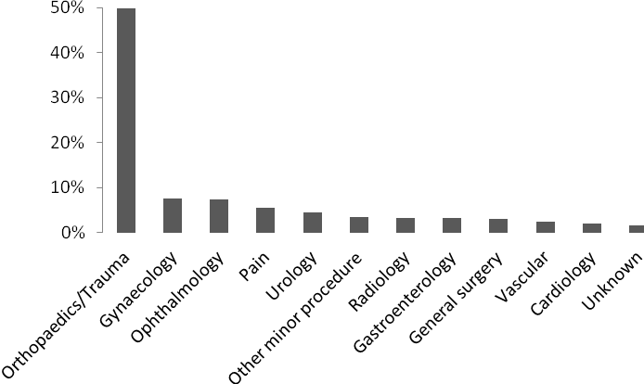
Sedation (all levels)
Sedation workload

Slide 23
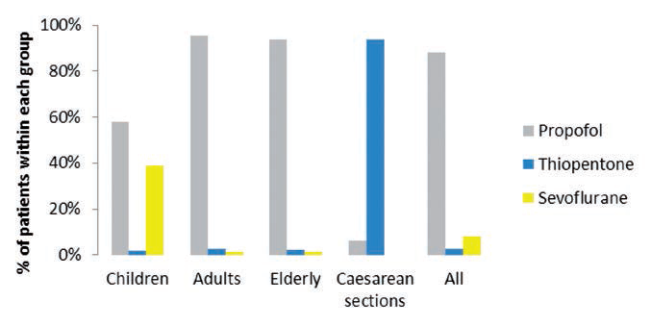
Induction agent

Slide 24
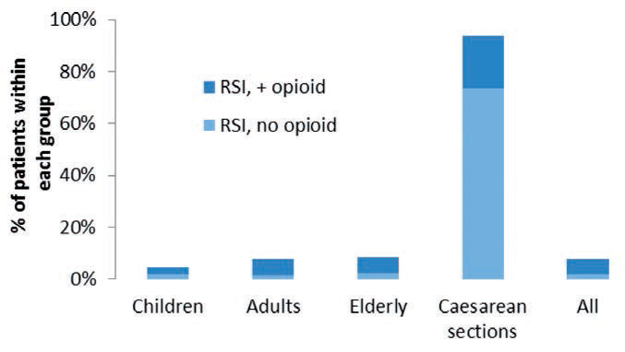
Rapid Sequence Induction (RSI)

Slide 25
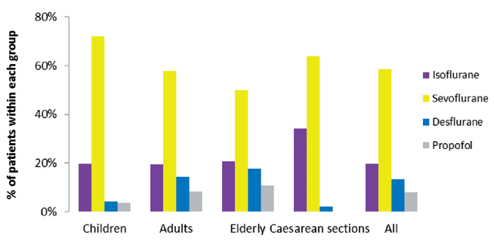
Maintenance agent

Slide 26
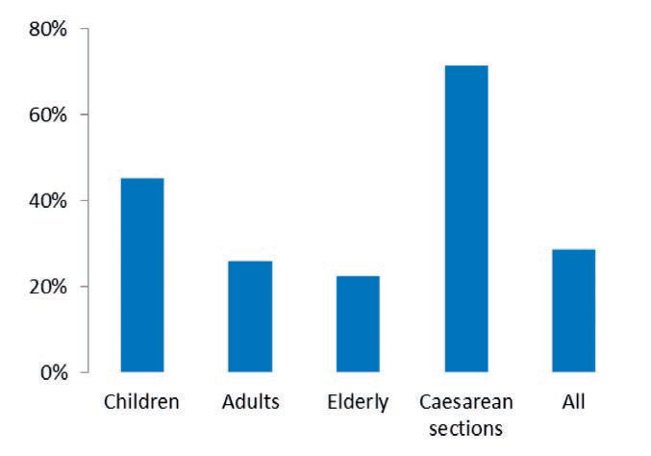
Nitrous oxide

Slide 27
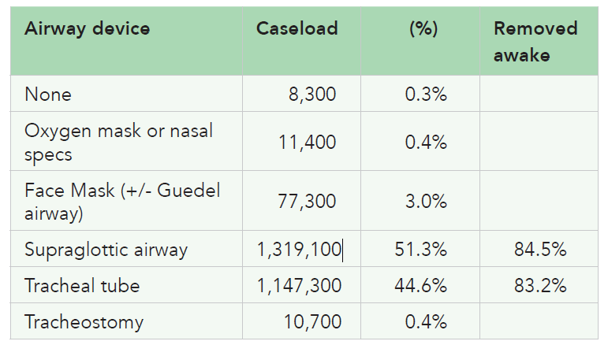
Main airway device used during GA

Slide 28
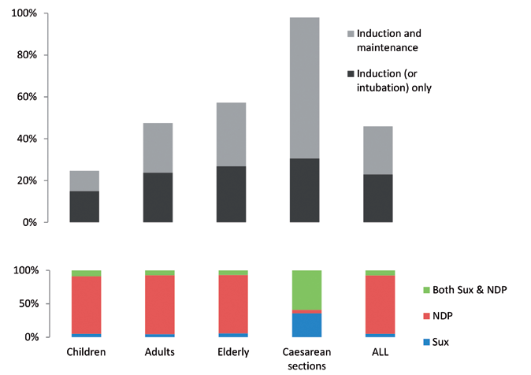
NMBs

Slide 29
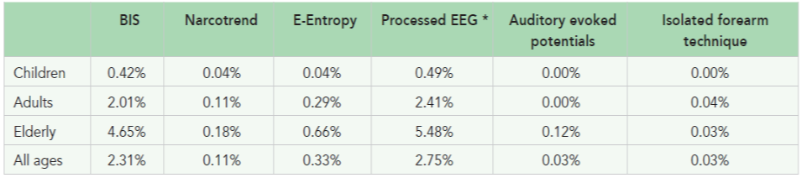
DOA monitors during general anaesthesia

Slide 30
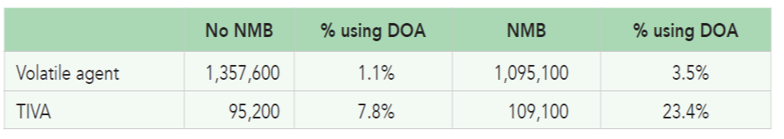
DOA monitoring: maintenance agent and NMB

Slide 31
4 learning points:
“most comprehensive national picture of anaesthesia practice to date”
NHS anaesthetists deliver approximately ~2.8 million general anaesthetics in a year
Non-GA ~ 25% of total activity

Slide 32
Challenges: consultant presence
Majority of patients are managed by consultants, irrespective of the patient’s ASA grade.
BUT consultants were present in
57% of urgent and immediate cases
26% of category 1 and 2 Caesarean sections
For ASA 4 and 5 cases
50% outside daytime hours v 80% during the daytime
47% during weekends v 70% at other times of the week

Slide 33
Future?
In planning an anaesthetic service for a large population, datasets such as ours are likely to be valuable.
If major changes in anaesthesia are planned, we propose that another census should be undertaken to determine its effects

Slide 35
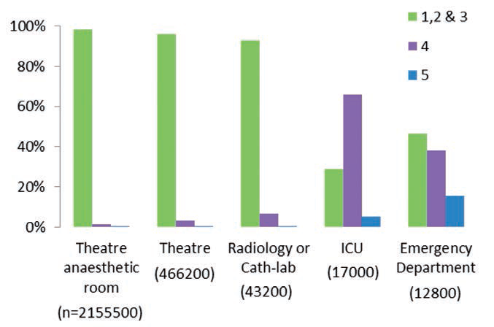
Location of induction

Slide 36
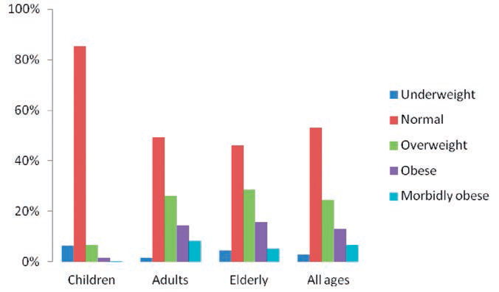
Obesity

Slide 37
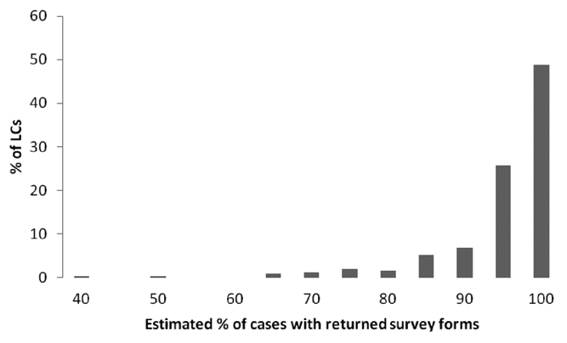
Results
All 267 LCs took part in the survey
median return rate 98%

