Slide 1
Main results and incidences
Professor Jaideep J Pandit
Clinical Lead, NAP5

Slide 2
269 UK centres
108 filed zero returns over the year
161 (60%) centres had a report
471 requests to upload data
341 logins issued (130 inadmissible)
321 logins used (20 unused)
300 accepted (21 judged inadmissible)

Slide 3




Slide 4
What’s inadmissible? (1)
- complex medical history kidney disease, electrolyte imbalance
- anaesthetic uneventful – included NMB and nerve stimulator
when fully awake, patient complained of leg and arm weakness that lasted 12 h. The patient was very distressed and experienced sleep disturbance for several weeks
no report of ‘awareness’ → inadmissible

Slide 5
(2)
Patients moved during surgery (one sat up), anaesthesia deepened, no AAGA on direct questioning
→ patient responsive during surgery
But no report of AAGA, so inadmissible

Slide 6
Main focus is on certain/probable and possible reports
We can compare % Activity Survey vs AAGA s ‘relative risk’ or ‘hazard ratio’
In following graphs, proportions
  Lines = Activity Survey
  Bars = AAGA

Slide 7
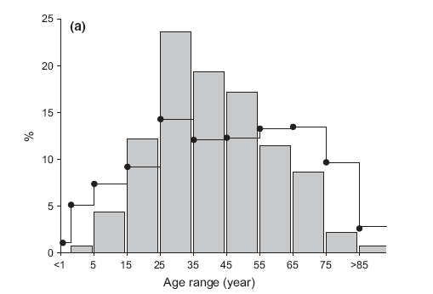
Age
AAGA most in young/middle age adults (viz. Baseline)

Slide 8
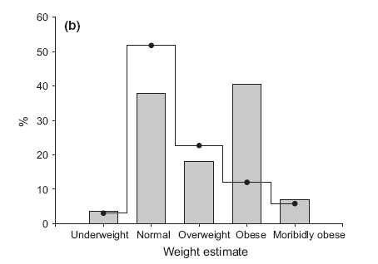
Weight
AAGA more in obese

Slide 9
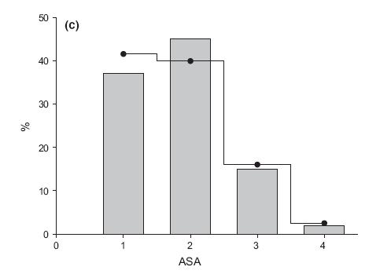
ASA
Not influential (ASA 3/ 4 more sensitive to drug; get less drug?)

Slide 10
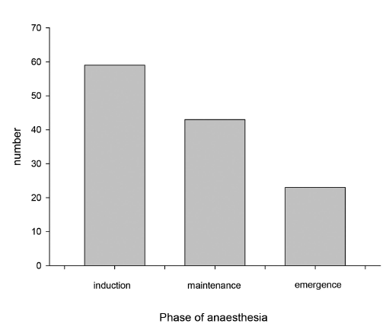
Phase of anaesthesia
Most common in dynamic phases (Baseline)

Slide 11
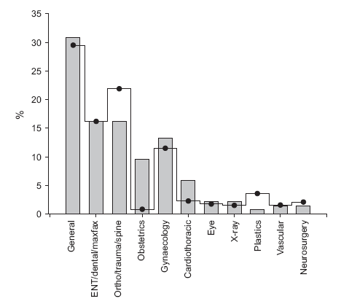
Types of surgery
OB and cardiothoracic over-represented…

Slide 12
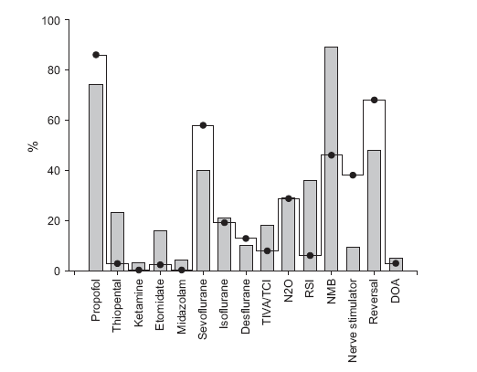
Modes of anaesthesia
Full profile

Slide 13
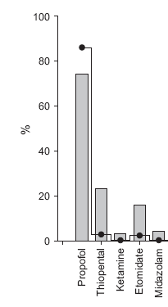
Induction
Thiopentone:
RSI/OB
3% of all inductions
87% if RSI inductions
Etomidate? RSI
(not used so much;
unfamiliarity?)

Slide 14

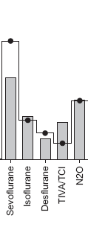
Maintenance
TIVA a risk?
N2O ‘neutral’
(less volatile used, so net
effect neutral?)
Sevo protective??
(agent-specific effects?)

Slide 15

NMB
The ‘unholy trinity’ that leads
to AAGA
- NMB
- no n stimulator
- no reversal

Slide 16
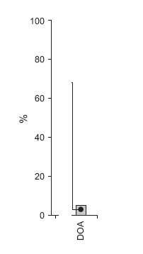
DOA
To be discussed:
DOAs not relevant to AAGA
in the UK (used in just 2.8% GA)
Use in Activity Survey 2.8%
Use in AAGA cases 4.3%
→ over-represented x 1.5
(superficially ‘a risk’)

Slide 17
“Incidence”
Incidence of what?
AAGA highly heterogenous
Different methods look at different things
Brice = ~1:600
Baseline = ~1:15,000
NAP5 main study 1: 19,000 - aggregate

Slide 18
Incidence subgroups…
All patient reports, valid, substantiated or not (n = 471)
1: 6,000

Slide 19
Admissible patient reports (n = 300)
1: 12,000

Slide 20
Certain/probable or possible only (n = 141)
1: 20,000

Slide 21
When no NMB used
1 : 136,000
When NMB used
1: 8,200

Slide 22
Cardiothoracic
1 : 8,000 (same as NMB)
Caesarean section
1: 670 (close to Brice)

Slide 23
Paediatric
1: 61,000
AAGA reports after sedation by anaesthetists
1: 15,000
(AAGA more common after sedation than GA)

Slide 24
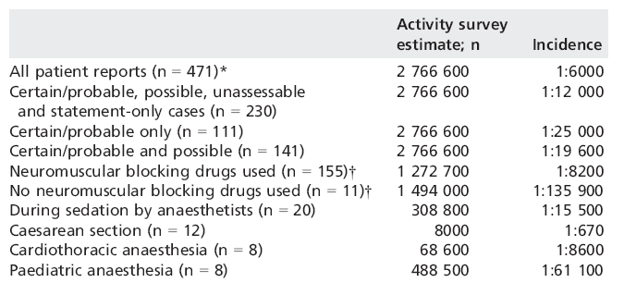

Slide 25
No single ‘incidence’
Brice differs from NAP5
NAP5 main study differs from Baseline
Within NAP5, differences in incidence between categories
Different methods look at different things
Different entities differ in degree to which detected by methods
These differences need researching

Slide 26
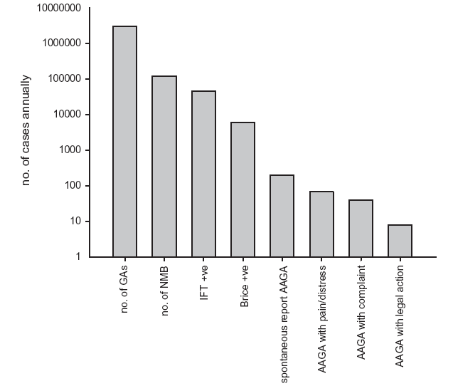
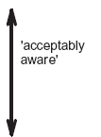


Slide 27
Conclusions
AAGA risks (overview) appear to include:
Middle age
Obesity
Thiopentone as induction agent (etomidate)
RSI
OB and cardiothoracic
NMB, esp with no monitoring or reversal
TIVA/TCI (to be discussed)
DOA monitoring (! – to be discussed)

Slide 28
Conclusions: incidence
While Brice = 1:600, NAP5 mean = 1:19,000
However:
From 1: 135,000 (no NMB) to 1:8,000 (NMB to 1: 670 (LSCS)
No single ‘incidence’ as this is highly context-specific
For this reason, rest of day delves into specifics of those contexts END

