Slide 1
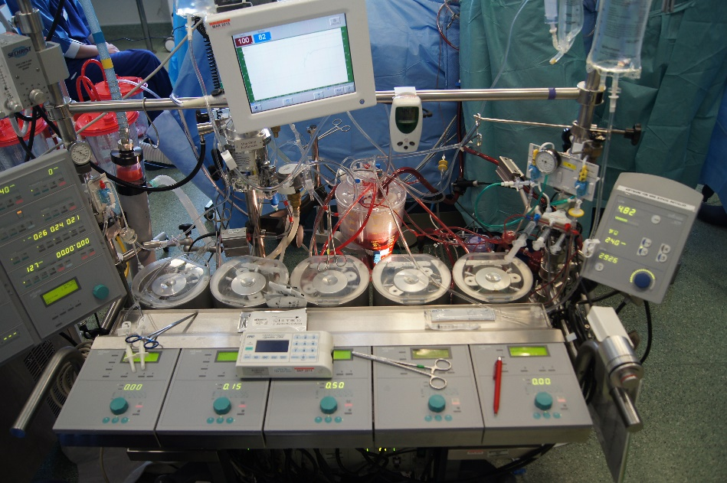
AAGA in Cardiothoracic Anaesthesia
Jonathan Mackay
September 2014

Slide 2
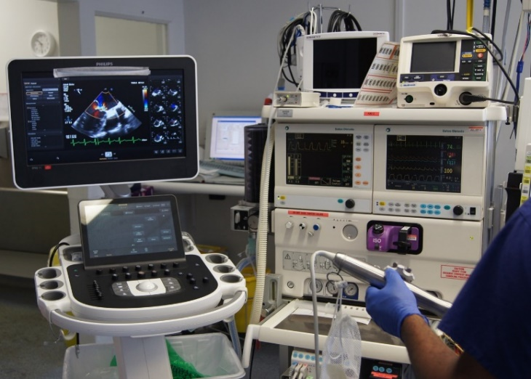
Cardiothoracic Lecture Objectives
Rationale for increased risk of AAGA in cardiothoracic surgery
Reported incidence AAGA versus other sub-specialties
Case reviews
Results interpretation

Slide 3
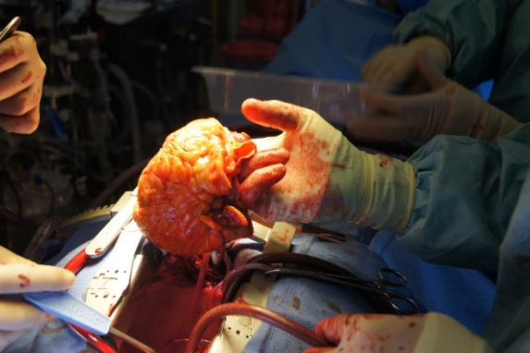
Cardiac Anaesthesia Risks Cardiac surgical patients considered at increased risk of AAGA. High-risk in cardiac surgical patients deemed particularly vulnerable
Opioid based techniques
Minimal cardiac reserve
Emergency surgery
Intentional underdosing of anaesthetic drugs to avoid cardiovascular instability
Reported incidence of AAGA with modern anaesthetic techniques ~1.1%
(Phillips et al 1993)
Notes:
Almost half of the patients in the B-Aware study underwent high-risk cardiac surgery (Myles et al 2004).

Slide 4
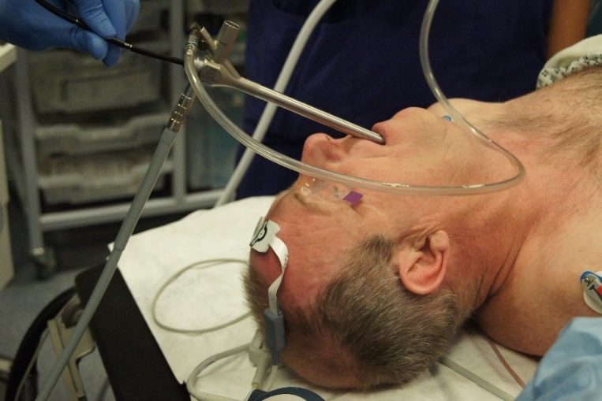
Thoracic Anaesthesia Risks Thoracic surgical patients are also considered at increased risk of AAGA
Neuromuscular blockade to facilitate one lung ventilation
Frail and elderly population
Rigid bronchoscopy associated with particularly increased risk
Challenging due to ‘shared airway’ with the surgeon and need for
deep anaesthesia,
full neuromuscular blockade
rapid recovery.

Slide 5
Cardiac Reports
Four class A reports during cardiac anaesthesia
i.e. certain or probable AAGA
Location of four cardiac surgical AAGA cases
Catheter laboratory procedure (n=1)
Theatres (n=3)
During primary surgical procedure (n=2)
During return to theatre for bleeding (n=1)

Slide 6
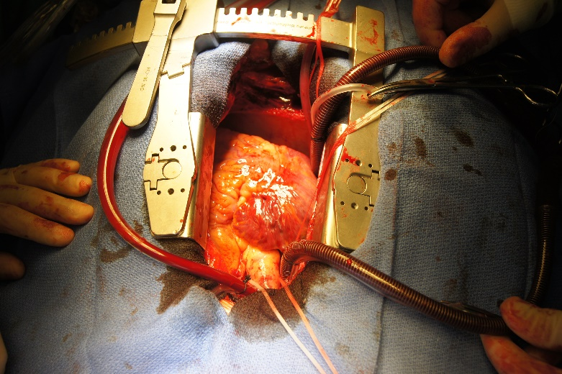
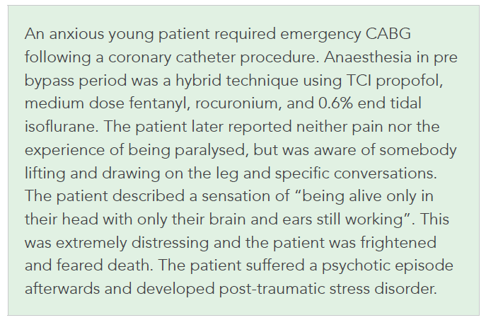
Cardiac Case Report I
Anxious young emergency CABG

Slide 7

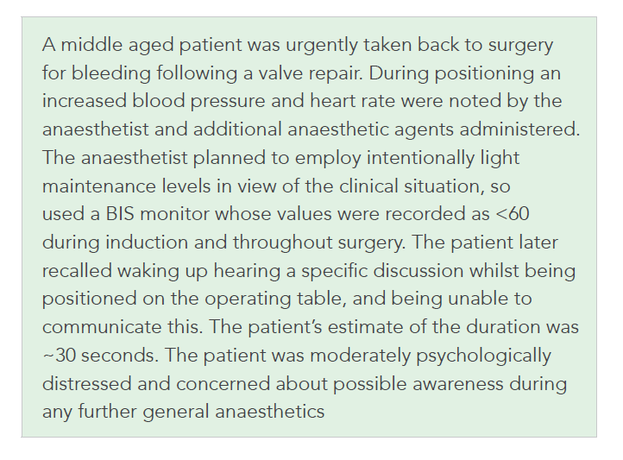
Cardiac Case Report II
Take back for bleeding with BIS
Intentional ‘light anaesthesia’ to avoid cardiovascular instability

Slide 8
Cardiac Summary
Cardiac cases ~1% of total UK reported caseload during activity denominator survey
~40,600 cardiac cases annually
Incidence of AAGA or ~1:10,000 (~0.01%).
twice as high as overall NAP5 incidence of ~1:20,000
much lower than reported incidence of ~1:150 in previous cardiac surgical series

Slide 9
Thoracic Reports
Four class A reports during thoracic anaesthesia
i.e. certain or probable AAGA
One report at induction
failure to turn on the vaporiser after inserting a double lumen tracheal tube.
Two reported cases during primary surgical procedure
one due to a failure to recommence vapour on moving to the operating room
One due to a tissued intravenous cannula
One case in Recovery
inadequate reversal of neuromuscular blockade with recall of extubation

Slide 10
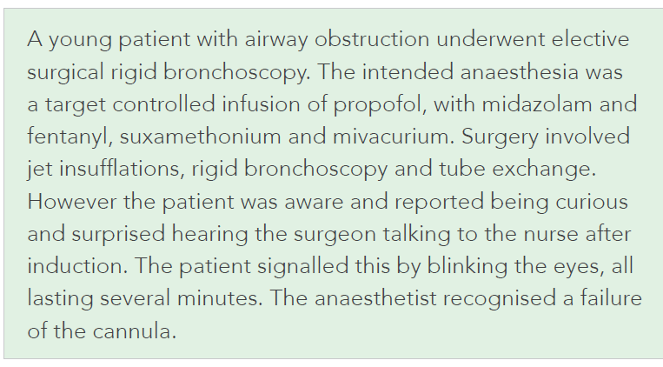
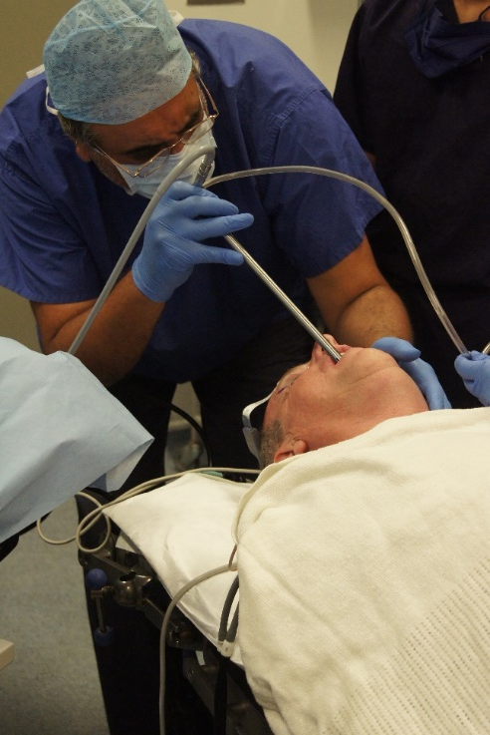
Thoracic Case Report
Tissued drip during TIVA

Slide 11
Thoracic Summary
Thoracic cases made up ~0.7% of UK reported caseload during the activity denominator survey
~28,000 cases annually
Thoracic AAGA incidence ~1:7,000
similar order to cardiac incidence
higher than overall NAP5 incidence of ~1:20,000

Slide 12
Depth of Anaesthesia Monitoring
Utilisation DoA monitoring in activity survey and reported AAGA cases
Cardiac
Thoracic
31% of cardiac cases in activity survey
One of four (25%) cardiac AAGA reports
24% of thoracic cases in activity survey
None of four (0%) thoracic AAGA reports.
Too few cardiothoracic cases of AAGA reported to NAP5 to draw any meaningful conclusions regarding any preventative effect of DOA monitoring in this setting

Slide 13
Discussion I
Overall cardiothoracic incidence of ~1:8600 much lower than previous reported incidence
Differences in NAP5 methodology versus other studies using Brice discussed elsewhere.
Additional factors may explain the disparity …

Slide 14
Discussion II
Cardiothoracic patients are invariably warned pre-operatively that they will be tracheally intubated with invasive monitoring when awakening in ICU
Elderly cardiothoracic patients may be more tolerant and less liable to mention AAGA
no reported cases of AAGA in patients aged >50 during primary cardiothoracic surgical procedure.
Notes:
The experience of awakening whilst the lungs are ventilated and with limited ability to move is therefore not entirely unexpected.

Slide 15
Discussion III
The NAP5 incidence may reflect changes in anaesthetic practice
greater attention to maintaining anaesthesia during periods of haemodynamic instability and cardiopulmonary bypass
Cardiothoracic population lends itself to research
relating to whether EEG-based monitoring helps to optimise balance between too light and too deep levels of anaesthesia
Notes:
Recommendation 29
Intentional underdosing of anaesthetic drugs at induction to avoid cardiovascular instability is appropriate in some circumstances, but the risk of AAGA should be considered and where it is unavoidable:
(a) The higher risk of AAGA should be communicated to the patient.
(b) Invasive monitoring should be considered to allow accurate early use of vasopressor drugs to enable adequate doses of anaesthetic agents to be administered safely.
(c) Specific depth of anaesthesia monitoring should be considered.

