Slide 1

Drug Errors and Awake Paralysis
Jon Mackay Kate O’Connor Tim Cook
September 2014
Notes:
The majority of the NAP5 Report focuses on failure of general anaesthesia – that is when general anaesthesia was intended yet the patient remained conscious.
Cases of brief awake paralysis as a result of drug errors which led to a neuromuscular blocking drug being administered without prior anaesthesia accounted for approximately 10% of reports to NAP5

Slide 2
Learning Objectives
Incidence and causes of drug errors
Errors leading to awake paralysis
Psychological sequelae for patient
Optimum management
Preventative strategies

Slide 3
Background
Recent incident reporting studies suggest a rate of drug errors of one in every 140 anaesthetics
  (Webster et al 2001; Zhang et al 2013).
Drug errors leading to awake paralysis are much rarer
Many errors are due to slips or lapses
Reason’s classic ‘Swiss cheese model’ of human error in medical care
Notes:
An early landmark study of human error as a cause of untoward anaesthetic outcomes was published by Cooper et al. (1978). At that time, a syringe swap or the unintended administration of an incorrect drug was the third most common cause of anaesthetic critical incident (human error involving disconnection of circuit or inadvertent changes in gas flow being the two commonest). Syringe swaps now account for an even higher proportion of critical incidents in anaesthetic practice because, over time, the latter two have been virtually eliminated.
This is almost certainly an underestimate as many unrecognized errors are not reported. Given these
odds, it is almost inevitable that an anaesthetist will make drug errors during their career; yet many
practitioners remain in a state of denial that they could make such an error, preferring to believe that
they are less fallible than their colleagues (Evley et
al., 2010).

Slide 4
Drug Error Definitions
Types of error causing awake paralysis in NAP5
A syringe swap occurs when a drug from the wrong syringe is administered
A drug labelling error occurs when the contents of the syringe are different to that indicated on the label
A drug omission occurs when the intended drug is omitted due to failure to draw up a drug in a dilutant
Notes:
4th type of drug error – flushing retained muscle relaxant in the dead space of venous cannula or extension can also lead to awake paralysis typically in Recovery

Slide 5
Results
There were 17 cases consisting of
  Ten syringe swaps
  Six drug labelling errors
  One omission error
  Events typically
    occurred during daytime hours at induction
    were reported immediately.
    resulted in very short perceived durations of paralysis
Notes:
Glass G: Drug error and miscellaneous. This was originally used as a miscellaneous category to be reviewed at the end of the data collection period.
In fact, this class rapidly filled with syringe swaps and drug errors, with only three remaining other cases.

Slide 6
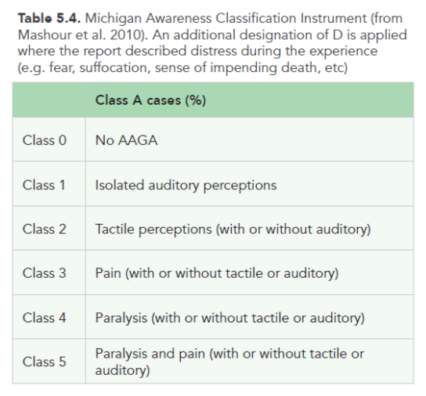
Michigan Awareness Classification
Notes:
The psychological sequelae of AAGA for the patient (measured by the Michigan and NPSA scores) in this setting can be particularly severe (Mashour et al., 2010; www.npsa.nhs.uk).

Slide 7
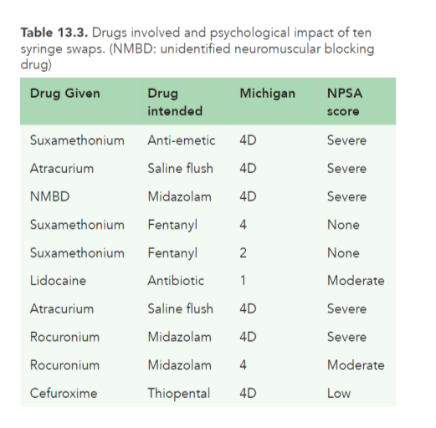
Drugs involved and psychological impact of ten syringe swaps
Notes:
The psychological sequelae of AAGA for the patient (measured by the Michigan and NPSA scores) in this setting can be particularly severe (Mashour et al., 2010; www.npsa.nhs.uk).
The majority of syringe swaps that led to AAGA in NAP5 were due to events that lead to administration of a neuromuscular blockade without being preceded by a hypnotic agent

Slide 8
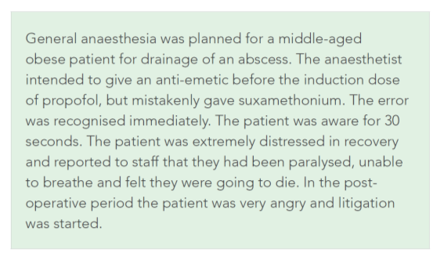
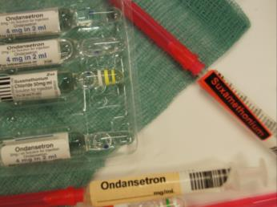
Syringe swap I suxamethonium versus ondansetron

Slide 9
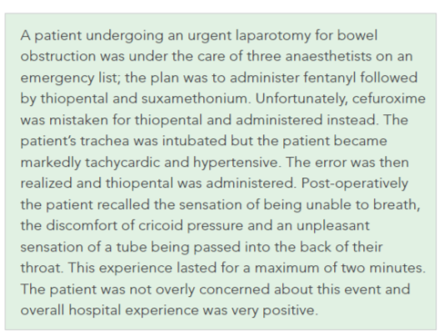
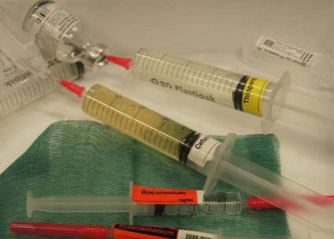
Syringe swap II cefuroxime versus thiopentone
Notes:
Recommendation 50
Anaesthetists should regard the presence of antibiotic syringes during obstetric induction as a latent risk for
drug error leading to AAGA. The risk can be mitigated by physical separation, labelling or administration of
antibiotics by non-anaesthetists. Using propofol for induction mitigates the risk of this drug error

Slide 10
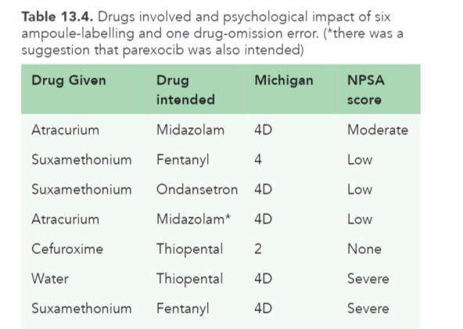
Ampoule labelling and drug omission errors
Notes:
Drug omission was failure to draw up thiopental

Slide 11
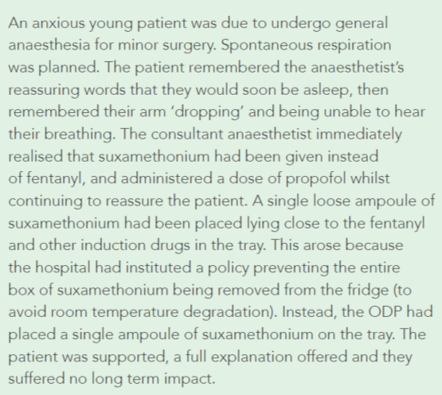
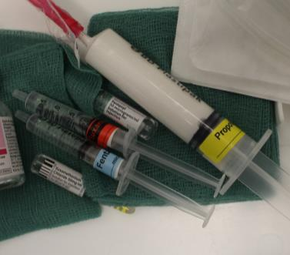
Drug labelling error I suxamethonium versus fentanyl

Slide 12
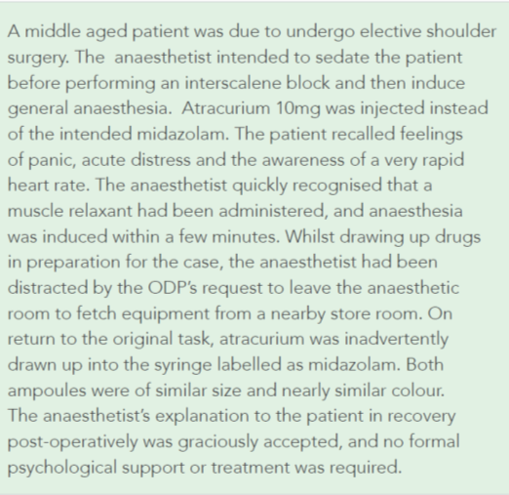
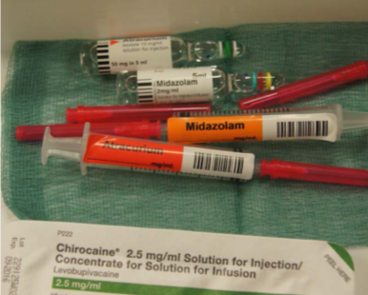
Drug labelling error II atracurium versus midazolam

Slide 13
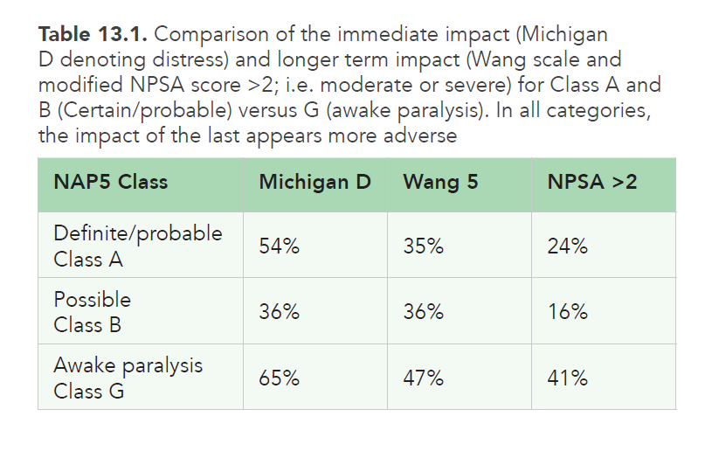
Immediate Impact: Class A & B vs Class G
Notes:
Although pain was rare, distress was more common during brief awake paralysis than in definite and probable cases of AAGA

Slide 14
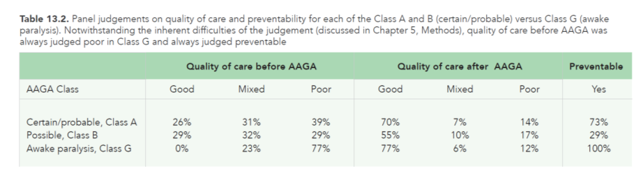
Panel judgements on quality of care
Class A & B vs Class G
Notes:
1. All cases of awake paralysis were preventable
2. Quality of clinical care was generally deemed to be poor or suboptimal in the period leading up to the event.
3. In contrast, quality of care after the event was frequently good, largely because the event was promptly recognised and well managed

Slide 15
Incidence
Very low reported incidence of unintended awake paralysis
Activity Survey indicates that approximately 1.25 million cases involving neuromuscular blockade are undertaken per annum
The 17 reported cases of accidental paralysis represent an overall incidence of one in every 70,000 general anaesthetics involving neuromuscular blockade.
Notes:
These cases were rich in organisational and individual latent factors that made such events
more likely. These included ill considered policies for drug management, similar looking ampoules,
poorly organised operating lists, high workload, distraction and hurriedness. Prevention of such
events requires action from national organisations (e.g. to improve drug labelling and packaging),
organisations (e.g. to ensure safe management of operating lists) and individuals (e.g. to develop clear personal strategies for drug preparation – particularly neuromuscular blockers).

Slide 16
Discussion
Majority of drug errors causing awareness due to simple syringe swaps of similar sized or similar coloured fluids
Recurring themes were staff shortages, ‘busy lists’ and distraction at critical moments
Lack of vigilance and having several similar sized syringes on the same drug tray may also have been contributory.
Notes:
similar sized syringes, or similar coloured fluids, such as suxamethonium vs. fentanyl or ondansetron (all
normally drawn in 2ml syringes); non-depolarising drugs vs midazolam (both normally in 5 ml syringes);
or antibiotics vs thiopental (both usually in 20 ml
syringes). Indeed, not a single error was reportedIndeed, not a single error was reported for
dissimilar sized syringes (Tables 13.3 and 13.4).
Distractions during critical moments can have very serious consequences. Jothiraj el al. (2013) reported
that other anaesthetists and circulating nurses are the most common causes of distractions.

Slide 17
Strategies to reduce drug error
Anaesthetists need to accept that we
are all prone to making errors
need to develop robust individual mechanisms to protect ourselves and our patients
Notes:
There have been several solutions suggested to reduce the incidence of drug errors in anaesthesia
and other branches of medicine. These include checking drugs with another person before
administration (‘two person checking’ or ‘double checking’) and also the use of technology (bar
code scanning). Both systems have been trialled in anaesthesia (Evley et al., 2010).
Although checking ampoules and labels with a second person is theoretically attractive, the evidence base for checking with a second person before drawing up or giving a drug is weak. Although double-checking is accepted as necessary in other familiar settings (e.g. the administration of blood products), the value of checking routinely
administered drugs in the anaesthetic context is more controversial.
When two people are responsible for the same task, neither person is truly responsible. There are several examples of this phenomenon in this report,where two anaesthetists have been present duringa case, yet perhaps nobody was truly leading the team. Paradoxically, the introduction of doublechecking for routine drug administration could
worsen ‘involuntary automaticity’ and reduce, rather than increase, patient safety.

Slide 18
Strategies to reduce drug error
Double checking of ampoules and labels with a second person?
Pre-prepared drug syringes and scanning technology to ‘check’ drugs before administration?
Notes:
A technical solution to the problem would involve use of pre-prepared drug syringes and use of scanning technology to ‘check’ drugs before administration. Any method would need to accommodate the need for rapid response to a changing situation during surgery, and hence the need to have a range of drugs immediately available whose use was not anticipated.

Slide 19
Strategies to reduce drug error
Ampoule appearance should be taken into consideration when choosing suppliers
  frequent changes of drug suppliers should be avoided.
Greater attention to organisation of the anaesthetic workspace
  possible separation of neuromuscular blocking drugs and other anaesthetic drugs.
Avoid overcomplicated anaesthetic techniques
  and unnecessary administration of drugs not directly involved in induction of anaesthesia

Slide 20
Management of drug error
Patient experience is greatly influenced by anaesthetic conduct after drug error
Avoid hurried efforts to reverse paralysis without attending to the patient’s level of consciousness

Slide 21
Management of drug error
When a drug error occurs it is important to recognise the potential for awareness early on
The first priority is to induce unconsciousness as promptly as possible
  difficult to imagine a scenario where continued paralysis of a conscious patient is justified.
  then, identify and reverse the neuromuscular blockade in a timely manner is necessary.
  during this time, verbal reassurance should be provided to the patient emphasising that
    the team knows what has happened,
    breathing is difficult due to the effects of the drug
    and that that the patient is not in danger.

