Slide 1
Patient factors
Nuala Lucas, Kate O’Connor,
Tim cook

Slide 2
Current knowledge
A wide variety of patient & organisational factors have been identified as being associated with increased incidence of AAGA
Results are markedly inconsistent
Features of Class A cases reported to NAP5 compared to same features of patients undergoing general anaesthesia in the Activity Survey
Notes:
KNOW in italics as the info is conflicting
The specific patient factors associated with AAGA have been investigated/identified in a wide variety of studies

Slide 3

Gender
Most studies report an increased incidence of AAGA in women
Women appear to recover more quickly from general anaesthesia than men
Closed claim analysis UK & USA demonstrates that higher number of claims come from women

Slide 4
Gender – NAP5
 | Class A cases (%) | Activity survey (%)
Female | 70 (63.6%) | 8109 (53%)
Male | 40 (36.4%) | 7183 (47%)
Total | 110 | 15 292
p = 0.026 for male vs female

Slide 5

Age
Age affects anaesthetic sensitivity and MAC
There are conflicting reports on the effect of age on the risk of AAGA

Slide 6
Age – NAP5
P<0.0001 for difference in age distribution AAGA reports vs Activity Survey
 | Class A cases (%) | Activity Survey (%)
<1 | 0 (0) | 197 (1.3)
1-5 | 1 (0.9) | 1 004 (6.6)
6-15 | 4 (3.7) | 1 447 (9.5)
16-25 | 15 (13.8) | 1 424 (9.3)
26-35 | 26 (23.9) | 1 701 (11.1)
36-45 | 19 (17.4) | 1 926 (12.6)
56-65 | 20 (18.2) | 2 128 (13.9)
66-75 | 12 (11.0) | 2 128 (13.9)
76-85 | 8 (7.3) | 1 928 (12.6)

Slide 7

Obesity
Obesity has been identified as a risk factor for AAGA
Obesity is associated with
  increased body fat content, lean body mass, blood volume & CO
  reduced total body water & alterations in plasma protein binding
  overall volume of distribution is increased
Notes:
Obesity is associated with increased body fat content, increased lean body mass, increased blood volume and cardiac output, reduced total body water and alterations in plasma protein

Slide 8
Obesity – NAP5
 | Class A cases (%) | Activity Survey (%)
Underweight | 4 (4) | 463 (3.1)
Normal | 36 (36.4) | 8 004 (54.3)
Overweight | 27 (27.3) | 3 514 (23.8)
Obese/morbidly obese | 32 (32.3) | 2 753 (18.7)
Total | 99 | 14 734
Not recorded | 11 | 906
p=0.01 for comparison of distribution AAGA vs Activity Survey

Slide 9

Difficult airway
Patients in whom airway management is
difficult may be vulnerable to AAGA
  due to offset of the effect of induction agents
  failure to administer anaesthesia during difficult airway management
  failure of volatile agents to reach the patient when mask ventilation is ineffective or there is airway obstruction
Obesity is a risk factor for difficult airway management

Slide 10
Difficult airway – NAP5
Difficulty with airway management was a factor in 27 Class A cases
23 reports described difficult intubation
5 reported difficult mask ventilation
3 reported difficult SAD insertion
5 cases there were combined difficulties

Slide 11


Difficult airway & obesity
Of reports of AAGA in obese patients
  31% involved difficult airway management
  37% of the cases of difficult airway management associated with AAGA were in obese patients

Slide 12

Genetic resistance
AAGA may arise from an intrinsic resistance to anaesthesia
  271 published reports of AAGA reported that 1.6% described a previous history of awareness Ghoneim, 2009
  BAG-RECALL study 11% of patients with definite or possible AAGA had a previous history of AAGA Avidan, 2011
  Secondary analysis of 26,490 patients enrolled in 3 major trials investigating AAGA
    241 patients with a previous history of AAGA. had a 5-fold greater incidence of repeat AAGA
                Aranake 2013

Slide 13
Genetic resistance – NAP5
13/104 (22%) Class A reports in which preventability could be assessed it was deemed that AAGA was unpreventable and anaesthetic conduct was good
In 10 of these cases, panel considered one possibility was intrinsic anaesthetic insensitivity.
28 Class A patients underwent a subsequent GA & in 24 where information was available, there was no report of subsequent AAGA

Slide 14

Concomitant drug and alcohol use
A perception that concomitant use of drugs and alcohol may alter the risk of AAGA
Little robust evidence to support this
Sedative drugs might alter anaesthetic requirements by pharmacokinetic effects leading to altered drug metabolism
Drug and alcohol use may also alter pharmacodynamic sensitivity to anaesthetic agents leading to resistance

Slide 15
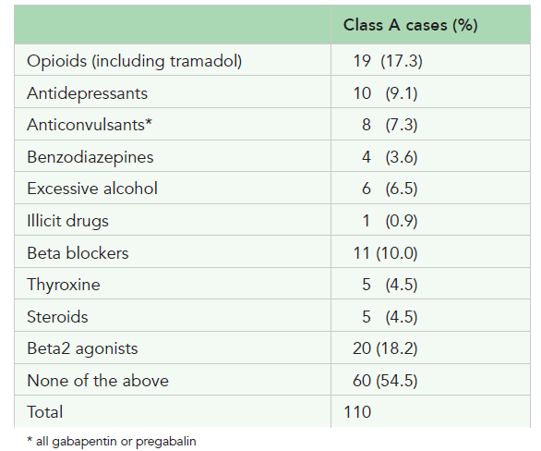
Concomitant drug and alcohol use
NAP5

Slide 16

Urgency of surgery
NAP5
P<0.0001 for the comparison of distribution AAGA vs Activity Survey
 | Class A cases (%) | Activity Survey (%)
Elective | 59 (53.6) | 10 416 (71.3)
Expedited | 6 (5.5) | 957 (6.6)
Urgent | 32 (29.1) | 2 892 (19.8)
Immediate | 13 (11.8) | 337 (2.3)
Total | 110 | 14 602
Not recorded | 0 | 858

Slide 17

Time of day
NAP5
P<0.0001 for the comparison of distribution AAGA vs Activity Survey
 | Class A cases (%) | Activity Survey (%)
Day (08:00-17:59) | 87 (79%) | 14 311 (97%)
Evening (18:00-23:59) | 17 (15%) | 723 (4.7)
Night (00:00-07:59) | 6 (5%) | 240 (1.6)
Total | 110 | 15 274
Not recorded | 0 | 186
Notes:
There was a disproportionately high proportion of
evening and nightime operating in Class A reports
of AAGA compared with the Activity Survey general
anaesthetics (see Table 1.10), p<0.0001.

Slide 18

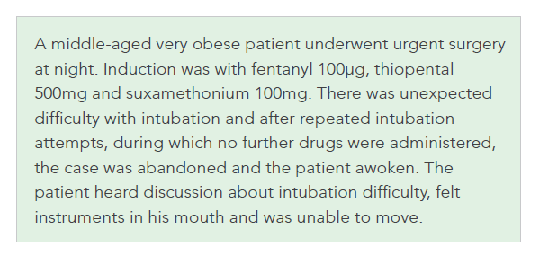
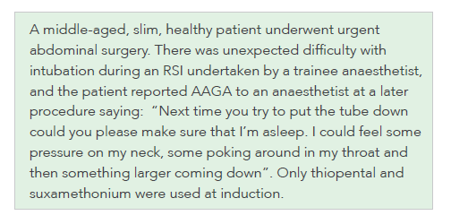
Case vignettes

Slide 19
Case vignettes

Slide 20
NAP5 risk factors
Female gender
Age (younger adults, but not children)
Body habitus (obesity)
Previous AAGA
Time of day (eve, night)
Urgency of surgery (emergencies)
Seniority of anaesthetist (junior trainees)
This analysis provides statistical evidence that the following factors are not risk factors for AAGA
ASA
Race
Use or omission of nitrous oxide.

Slide 21
Thank you

