Slide 1



The Patient Experience
Mr John Hitchman
RCoA Lay Representative

Slide 2
What we knew before
High level of public awareness of anaphylactic shock associated with triggers - nuts, venom etc.
Far lower levels of public knowledge of perioperative anaphylaxis - mainly with affected patients, carers and specialised charities
High variability of patient services following life-threatening incident - waiting times for clinic averaging 18 weeks rather than the ideal 6
Patients need to know the cause through written information they can understand

Slide 3
NAP6 - the patient journey and the patient expectations
Only an “informed” patient can give consent - risks need to be discussed beforehand
Opportunity for patients to ask questions and gain reassurance
Risk Note 9
Assurance that anaphylaxis can be recognised and treated promptly by anaesthetists

Slide 4
Patient allergy history
Clinical documentation not alway reliable - NICE guideline 183
Patient accounts may be unreliable - stress, pain
Anaesthetists need to be given time to establish allergy history

Slide 5
Vignette
A patient presented for elective surgery. They reported an allergy to penicillin and received teicoplanin prophylaxis as an alternative. They had a grade 3 allergic reaction to teicoplanin confirmed by allergy testing, which also determined that the patient was not actually allergic to penicillin.

Slide 6
Rapid diagnosis and immediate care
Anaphylaxis is rare - 1 in 10,000
Recognition and start of treatment - 66% within 5 minutes, 17% between 5 & 10 minutes

Slide 7
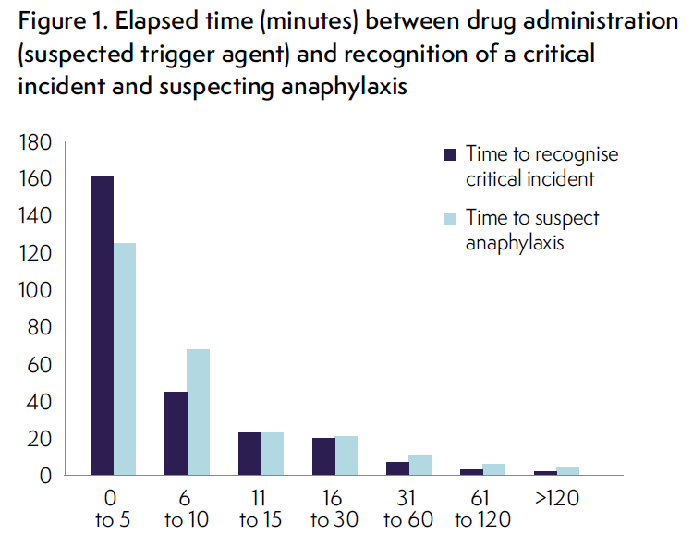

Slide 8
Hospital stay and discharge
Post anaphylaxis 1/4 of patients had normal outcomes and length of stay - 38% one extra day and the rest longer
Before discharge the patient needs a comprehensible letter that explains possible causes, risks and further action
Template letter at Appendix B of Chapter 11

Slide 9
Reporting
Low reporting rates to MHRA - 42 cases before allergy clinic appointment, 63 after
Only 40% of patient’s issued with Medic Alert card
No data about patient referrals to allergy charities

Slide 10
Immediate care and allergy clinic
In allergy Clinics Investigation of incidents was variable
Lack of clear pathways for prioritising

Slide 11
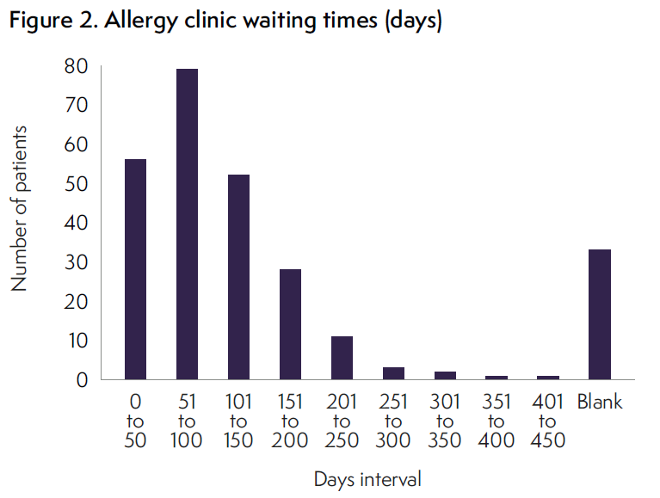

Slide 12
Vignettes
An elderly patient having elective cancer surgery had a grade 4 anaphylactic reaction after induction. The anaesthetist communicated with the allergy clinic and the patient was seen in little over a week. Surgery was rescheduled in a timely manner.
A young patient presented for elective general surgery. Although the procedure was abandoned at the time of the reaction it was completed before review in the allergy clinic. The clinic appointment was delayed for over 3 months

Slide 13
Room for improvement
Expediting and reduction in variation of wait times for allergy clinic appointments/investigations
Consistent investigation of perioperative anaphylaxis, adhering to published guidelines including identifying a culprit agent, excluding other possible culprits and identifying safe alternatives
Improvements in delivery and clarity of allergy information given to patients
Consistency of reporting to MHRA, Trust’s and GPs.

Slide 14
Medium to long term patient harm
Most commonly reported - anxiety about future anaesthetics and sedation
Lack of data - some improvement of symptoms over time
Other adverse sequelae included
Mood and memory changes
Occasional loss of coordination and mobility
Further analysis needed of anaphylactic harm during Caesarean section

Slide 15
Comment
Investment in improved provision versus other health services - aspirational!
One solution - remote access to drug allergy centres across U.K.
Webinar conferences - for multi-disciplinary teams

Slide 16
Recommendations
Consent needs to be informed - risks explained
Following event and before discharge - explanatory letter from anaesthetist
Standardisation of allergy clinic practice to provide consistent service
Research on physical and psychological well being of patients

Slide 17
Thank you

