Slide 1



NAP6 – deaths, cardiac arrests, profound hypotension and outcomes
Tim Cook
Director of NAP program
Consultant Anaesthesia/Intensive Care, Bath

Slide 3
What we already knew
Death from anaphylaxis usually <1 hr
4% commonly quoted for peri-op hypersensitivity (Grade 1-4)
0% (<1.4%) 0/264 Western Australia 2000-9 (Grade 1-5)
4% France 2018 (NMBA Grade 1-5)
Asthma increased risk (community)
Raised baseline MCT (envenomation)

Slide 4
What we already knew
Cardiac arrest
  <5 mins for drug induced
Elderly increased risk
Sadleir – no increased ‘risk’ if surgery completed in Grade 3(or 4) (167 pts)

Slide 5
DEATHS
Deaths
  10/ 266 (3.8%) grade 3-5 cases
  but we reviewed all deaths …… so could be 2.2%
  and only Grade 3-5
  1 in 313,000 procedures
  1 in 239,000 GAs
  NO ERRORS

Slide 6
Deaths
6 female/4 male
All age >45; 5 aged >65 (25% >65, 50% >45 in Activity survey)
6 ASA3, 2 ASA 4 (<2% ASA 4-5, 77% 1-2 in Activity survey)
Obesity (21% obese in Activity survey)
  1 normal weight,
  4 overweight,
  1 obese,
  4 morbidly obese
5 emergencies
3 cardiac operations (1% in Activity survey)

Slide 7
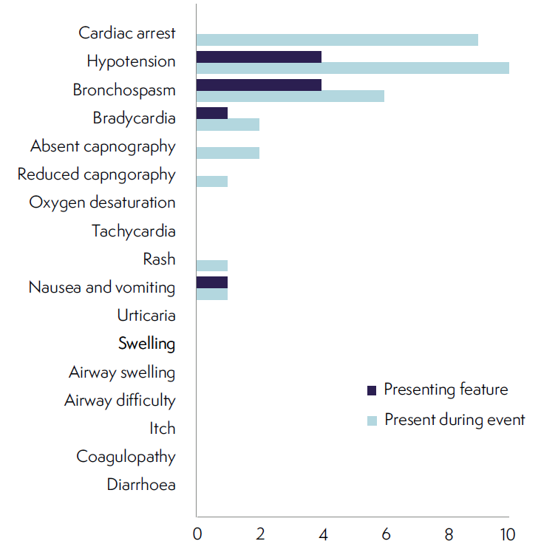
Clinical features

Slide 8
Clinical features

Slide 9
Deaths
All arrests PEA +/- bradycardia: no other arrythmias
Prolonged resuscitation
  5 survived resus
    median >39 mins, all >25 mins
    ECMO, PCI
  4 died of MOFS

Slide 10
Deaths
Onset
  7 = <5 mins
  3 = <10 mins
Delay in recognition =1
Prompt treatment = all
Complete – ALS
Adrenaline median 5mg (2-13)
  1 glucagon
  1 vasopressin
50% steroids
50% antihistamines
Modest fluids….1.5L

Slide 11
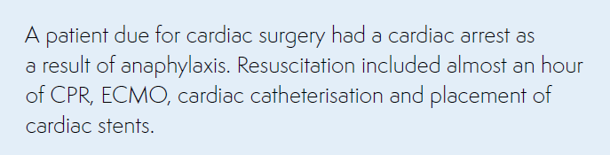

Slide 12
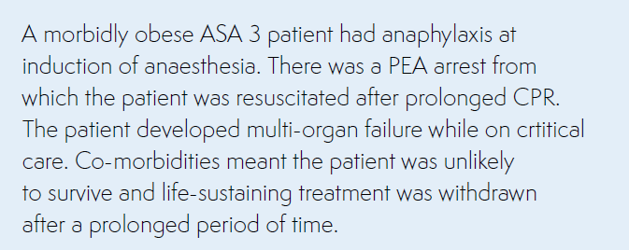
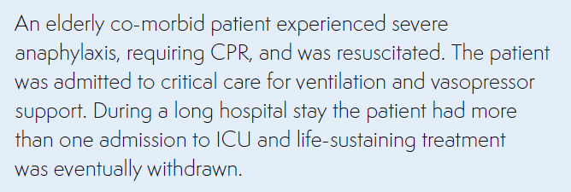
Deaths

Slide 13
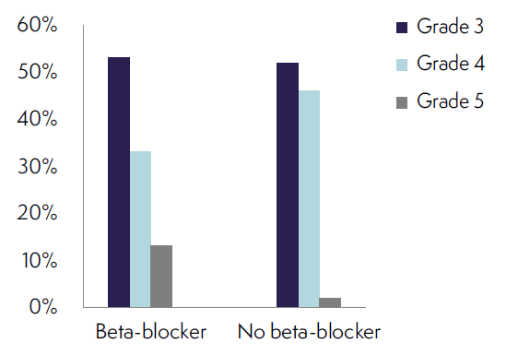
Beta blockade as a risk for death
Only 1 patient received glucagon
At 65 minutes

Slide 14

-old age
-cardiac disease
-obesity
– but not asthma
(no atopy either)

Slide 15
Culprits
Antibiotics and NMBAs – but not only

Slide 16
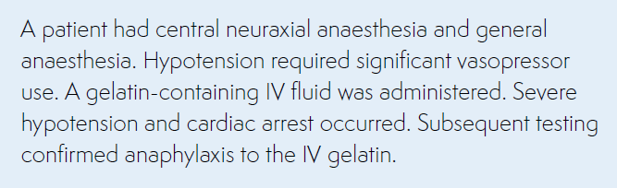

Slide 17
Deaths
All had MCTs done
None had sIgEs
None referred to or discussed with allergy clinic
None had PM details

Slide 18
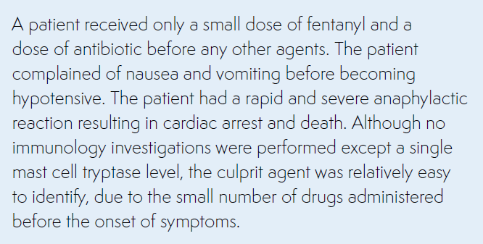

Slide 19
Cardiac arrest
40 cases (15%)(including 9 of the deaths)

Slide 20
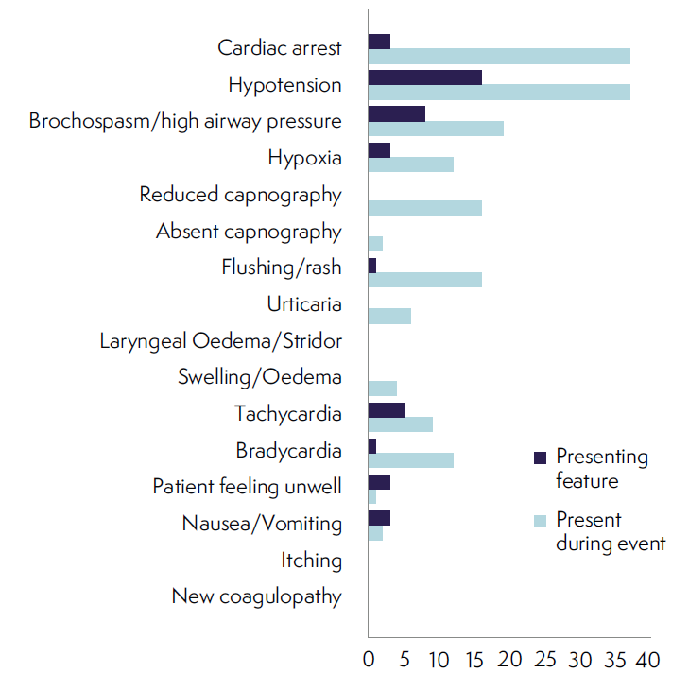
Clinical features of 37 cardiac arrests

Slide 21
Clinical features of 37 cardiac arrests

Slide 22
Cardiac arrest
40 cases (including 9 of the deaths)
Median duration CPR 8 minutes (survivors) (vs 39 mins deaths)
  PEA 85%
  VF 10% (all presented with tachycardia)
  Asystole 5%
Preceding hypotension 37.5%
Preceding arrythmia 15% (4 brady, 2 VT)
31 survived (77.5%)

Slide 23
Cardiac arrest
Not especially unfit
Nothing special about the drugs administered
More patients on ACEI
No evidence of adrenaline-induced complications (arrythmia, ischaemia)

Slide 24
Cardiac arrest
Average 5mg adrenaline
91% went to ICU – 90% level 3
  61% needed vasopressor infusions
  6% bronchodilators
  Typically 2 days in ICU
  No recrudescence
  1/3 patients reported longer term harm

Slide 25
Profound hypotension
Commonest presenting feature
Universal in Grade 3-5 peri-op anaphylaxis
  74% <60mmHg
  31% <50mmHg ‘without cardiac arrest’

Slide 26
Profound hypotension
Cases CPR
Cardiac arrest 15% 100%
Unrecordable BP 21% 50%
BP <50mmHg 22% 9%
BP 51-60mmHg 20% 2%

Slide 27
Profound hypotension
With invasive BP monitoring 50mmHg is a ‘pulseless state’
NIBP overreads in hypotension
…….So just when are you going to start CPR?

Slide 28
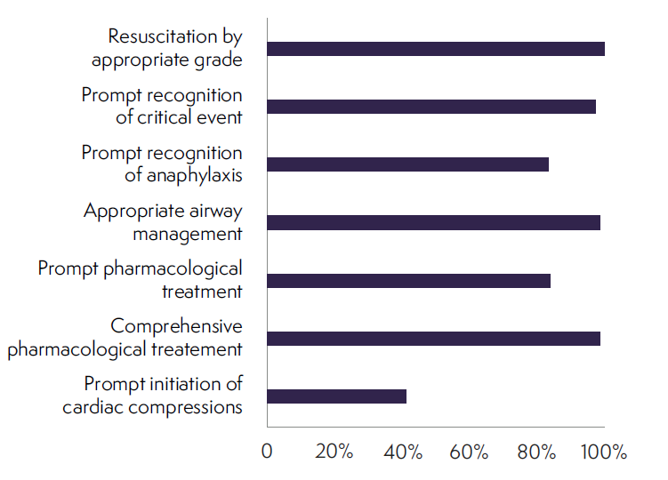
Anaphylaxis management
-good
-except CPR

Slide 29
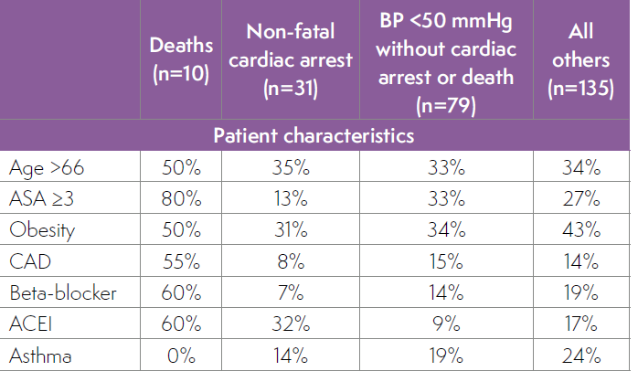

Slide 30
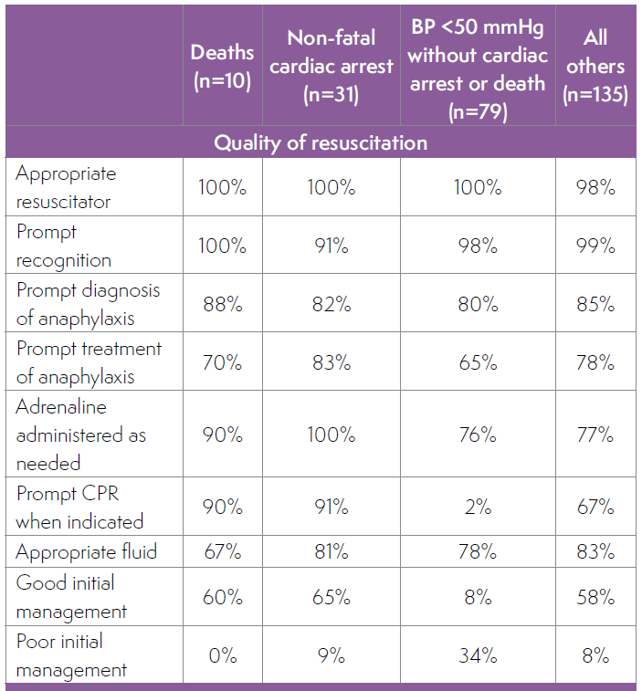

Slide 31
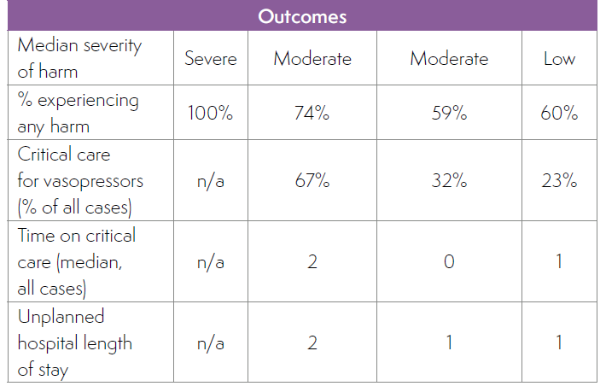

Slide 32
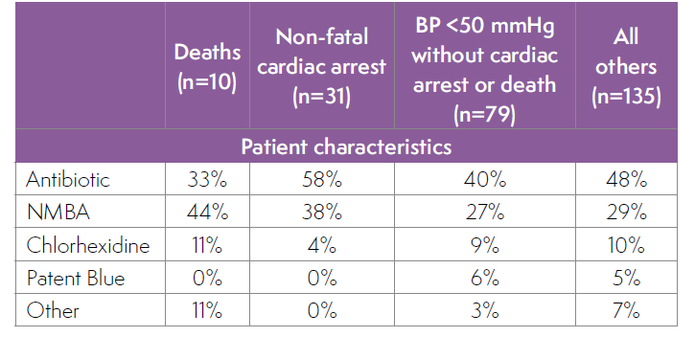

Slide 33
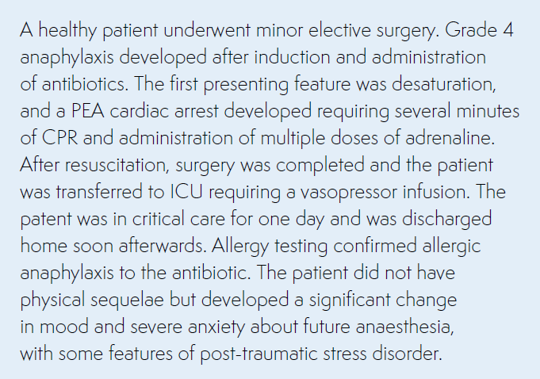
Outcomes

Slide 34
Outcomes

Slide 35
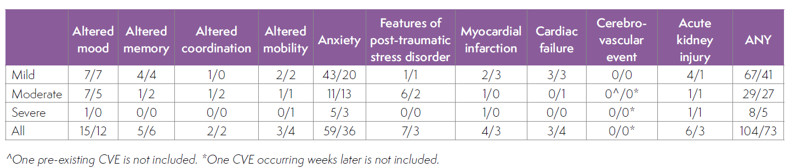
Outcomes

Slide 36
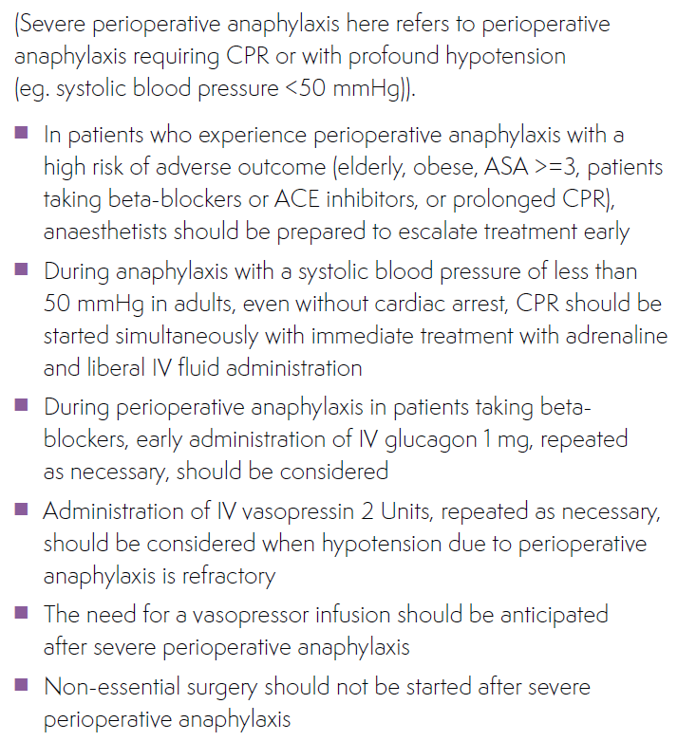
Recommendations

Slide 37
Recommendations

Slide 38
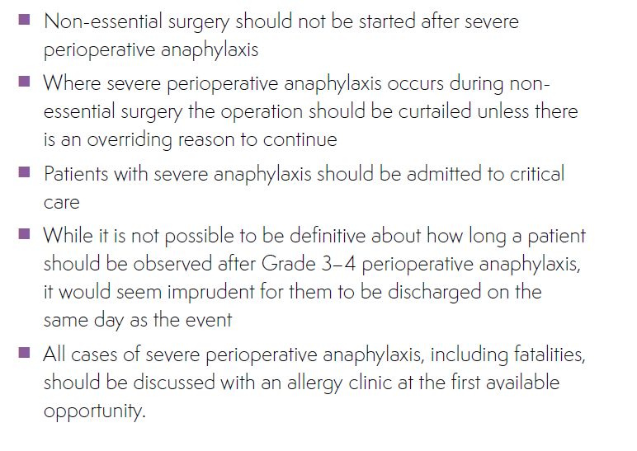
Recommendations

Slide 39
Summary
Deaths
  3.8%, cardiac, elderly, beta-blocker, ACEI, obese, prolonged resus
Cardiac arrest
  15%, ACEI, younger/fitter, well managed, brief CPR, good outcomes
Profound hypotension
  50%, delayed or no CPR, some poor outcomes
Outcomes
  1/3 altered outcomes, some major, anxiety, but overall good

