Slide 1

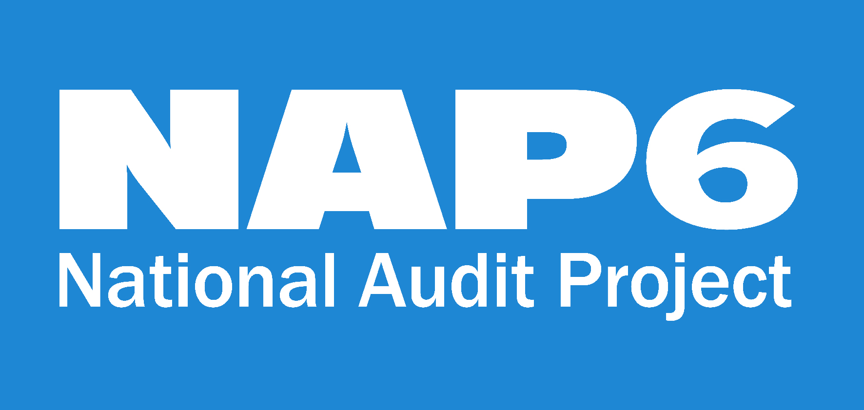
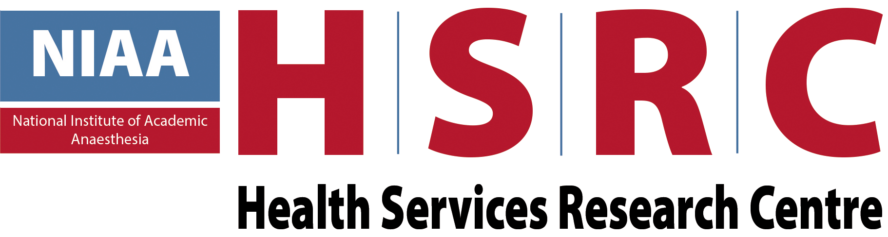
Neuromuscular Blocking Agents and reversal drugs Prof Nigel Harper Clinical Lead, NAP6

Slide 2
What we already know
Most studies have shown that NMBAs are the commonest cause (44-60%)of perioperative anaphylaxis
Previous studies have been hampered by limited information on actual NMBA exposure
Considerable geographical variation
Suxamethonium has the highest anaphylaxis rate
Cross-reactivity is frequent
Potential future risk from any NMBA
Non-allergic anaphylaxis can occur with atracurium and mivacurium

Slide 3
What is uncertain
What is the UK pattern of NMBA use?
Are NMBAs still at the top of the the anaphylaxis risk ladder?
Is NMBA-anaphylaxis more severe?
Is rocuronium higher risk than atracurium?
Is sugammadex effective in rocuronium-anaphylaxis?
Does exposure to pholcodine cough-medicine predispose to NMBA anaphylaxis?
How often is anaphylaxis due to reversal drugs?

Slide 4
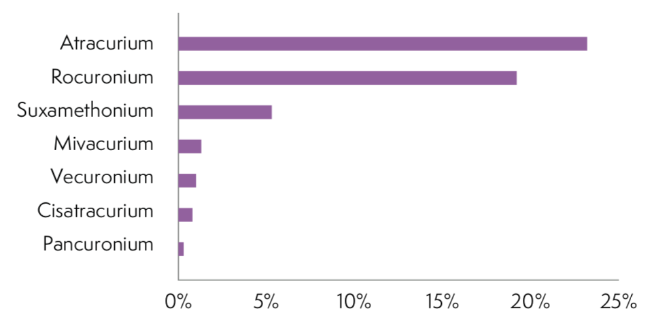
What is the UK pattern of NMBA use?
Atracurium is the UKs favourite NMBA
Cisatracurium hasn’t ‘caught-on’
NMBAs used in 47% of general anaesthetics
NMBA use is decreasing
Suxamethonium use is declining

Slide 5
Are NMBAs still at the top of the the ladder?
Antibiotics are the most common cause: 65 cases were due to NMBAs and 94 due to antibiotics
The highest-risk antibiotic teicoplanin* is more likely to cause anaphylaxis than the highest-risk NMBA suxamethonium**
NMBAs were suspected by the anaesthetist in 81 cases indicating a perception of high risk
67% of anaesthetists avoid an NMBA due to perception of high risk, and only 10.2% antibiotics
* 16.4/100,000 administrations. ** 11.1/100,000 administrations

Slide 6
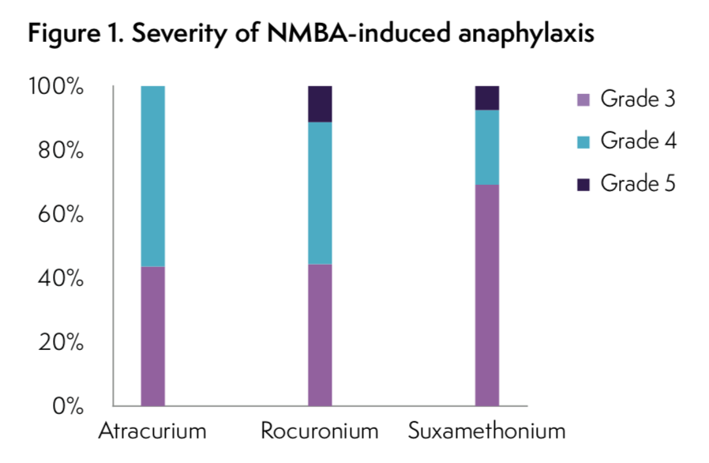
Is NMBA-anaphylaxis more severe?
NMBAs responsible for 40% of deaths and 33% of reactions
Fatalities: three rocuronium and one suxamethonium
Suxamethonium anaphylaxis less likely to be severe

Slide 7
Is rocuronium higher-risk than atracurium?
 | Cases confirmed | Proportion of UK NMBA usage | Anaphylaxis rate/100,000 uses
Suxamethonium | 14 | 11.2% | 11.1
Rocuronium | 27 | 40.6% | 5.88
Atracurium | 23 | 49.1% | 4.15
Mivacurium | 1 | 2.7% | 3.25
Vecuronium | 0 | 2.2% | –
Cisatracurium | 0 | 1.6% | –
Pancuronium | 0 | 0.6% | –
Suxamethonum clearly higher risk
Rocuronium v atracurium less clear due to wide 95% Confidence Intervals
Sux: 1 in 5, 368 – 1 in 16, 473
Roc: 1 in 11, 686 – 1 in 25, 799
Atra: 1 in 16, 069 – 1 in 38, 034

Slide 8
How often is anaphylaxis caused by reversal drugs?
A single case of sugammadex-anaphylaxis was reported
Sugammadex use has increased fourfold since 2013 and is now used in 5.7% of patients receiving an NMBA
Several cases of sugammadex-anaphylaxis have been reported worldwide.
No cases of neostigmine-induced anaphylaxis (used in 57.4%)
Seed and Ewan described a single UK case in 2000

Slide 9
Pholcodine exposure
There is evidence that exposure to pholcodine cough-medicines may cause sensitisation to NMBAs (Johansson 2010)
NMBA anaphylaxis has declined in Norway since withdrawal of pholcodine cough-medicines (de Pater 2017)
Previous exposure to pholcodine was sought by the allergy clinic in only 15 patients.
Both patients with recorded previous pholcodine exposure had NMBA anaphylaxis

Slide 10
Recommendations - NMBAs
Individual
Except in cases of known or suspected allergy to specific NMBAs, the risk of anaphylaxis should not be an over-riding factor in choice of NMBA
Research
Further research on population sensitisation by pholcodine is needed. If a causal association is confirmed, withdrawal of pholcodine-containing medicines from the UK market should be formally considered

Slide 11
Thank You

