Slide 1



NAP6 Paediatric cases Mark Thomas Paediatric Anaesthetist Great Ormond Street Hospital, London Council member, Association of Paedaitrc Anaesthetists GBI

Slide 2
Paediatric caseload
Children <16 yrs
Banded age 0-5 or 5-16 yrs
2053 cases giving an annual estimate of 402,753 paediatric cases
11 cases of grade 3-4 anaphylaxis
2.73/10k (CI 1.36-1.49) paediatric anaesthetics
vs 9.36 (8.42-10.59) adults P<.001
1: <5 years
10: 5-16 years

Slide 3
What the anaesthetist thought…..
Atracurium 3 cases
Single cases of ;
Lidocaine
Suxamethonium
Piperacillin/tazobactam
Teicoplainin
Aprotinin
Cefuroxime
Ibuprofen
Cryoprecipitate

Slide 4
What the panel thought (high certainty)
7 cases
2 atracurium
One each of the following
Aprotinin
Suxamethonium
Ibuprofen
Cefuroxime
(Vecuronium)

Slide 5
Allergen survey Children (n=2053)
Agent | Number | Proportion of cases receiving (%) | No. of cases NAP6
Atracurium | 282 | 14 | 3
Ibuprofen | 358 | 17.4 | 1
Cefuroxime | 70 | 3.4 | 1
Suxamethonium | 52 | 2.5 | 1
Aprotinin | 4 | 0.2 | 1
Cryoprecipitate | unknown | – | 1

Slide 6
Differences from adults
NMBAs 24.7% paeds cases vs 47% adults
Atracurium 57% of paeds NMBAs
Rocuronium 5.2% (21%)
Suxamethonium 2.5%(10%)
14% children sevoflurane-only anaesthetic
Antibiotics 26.4% paeds cases vs 57% adults
Teicoplainin 0.9% vs 7.1% adult periop.

Slide 7
Latex and Teicoplainin
Latex: more awareness of risk. Latex-free environment
Teicoplainin: relatively low use (0.9 vs 7%), less labelled as penicillin allergic

Slide 8
Clinical presentation: 1st feature
Bronchospasm/high airway pressures in 7(64%) of cases (all < 5 minutes post)
Hypotension: 2 (both >5 minutes post)
Tachycardia: 1
Rash: 1
Decreased ETCO2: 3 (2 @ zero)

Slide 9
Clinical presentation: any time

Slide 10
Management
Consultant involved in all cases
Bronchospasm (6/7) <5 mins. to resus. start
Hypotension/tachycardia or rash: slower
1 non-urticarial rash case >15 mins
10/11 received adrenaline median 2.5(0-9)
8/11 received hydrocortisone, 1 dexameth.
8/11 received chlorphenamine
8 MST (@least 1)
7 locally reported, 1 MHRA report, 2 hazard bracelets

Slide 11
Management: fluids
10 crystalloid
1 gelatin
1 no iv fluids
ml/Kg in hours after event: median (range)
Notes:
The volume of crystalloid administered during the first hour was 11.7-75 ml kg-1 (median 20.4 mlkg-1), between one and three hours 3.2-25 ml kg-1 (median 9.2 ml kg-1) and during the subsequent two hours 5.8-20 (median 8.3 ml kg-1 ).

Slide 12
Management: guidelines and judge
AAGBI 5 (45%)
RCUK 1 (9%)
Access to laminate in 7 (63%)
No-one used smartphone
Review panel: 7 good, 4 good and poor, poor in 1

Slide 13
Outcomes
No arrests (<60)
No deaths
1 report of patient/parent anxiety
1 report of child withdrawn behaviour

Slide 14
Investigation and follow-up
Challenging
Allergy clinic id 7 high confidence triggers
Panel id 8
7/8 : deviation from BSACI guidelines
Include: fail to test all possible triggers, fail to id potential safe alternatives, fail to establish baseline MST
5/8 judged still at risk or poor advice
None good, good and poor 4, poor in 4

Slide 15
Summary: Paeds
Rare 2.7:100,000
No deaths
Well managed
Atracurium single biggest trigger agent
Clinic and follow up can be improved

Slide 16

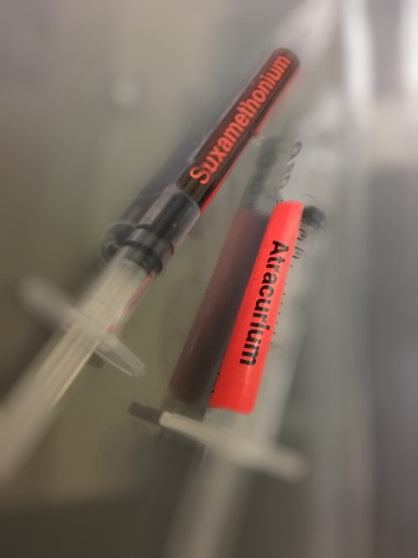
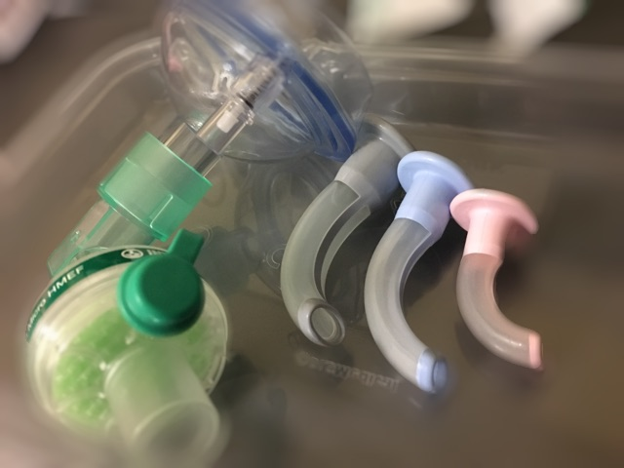
Many thanks

