Slide 1




National Audit Project 8:
Major Complications of Regional Anaesthesia and Perioperative Spinal Cord and Nerve Injury
in the UK and Republic of Ireland

Slide 2
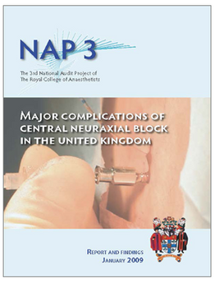
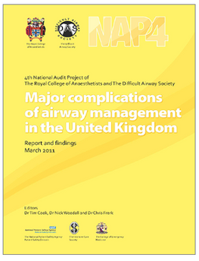
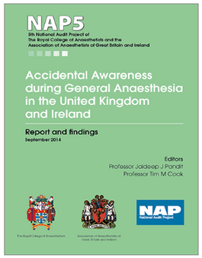
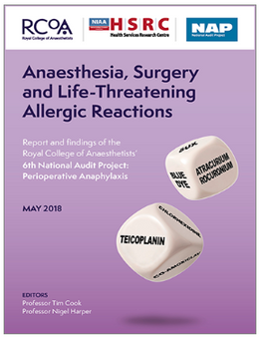
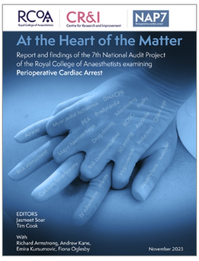
NAP8 - Background
National Audit Projects
  Serious but rare events
  Important to both patients and anaesthetists
  Incompletely studied by incidence or nature
  Not suitable for study by other methodologies

Slide 3
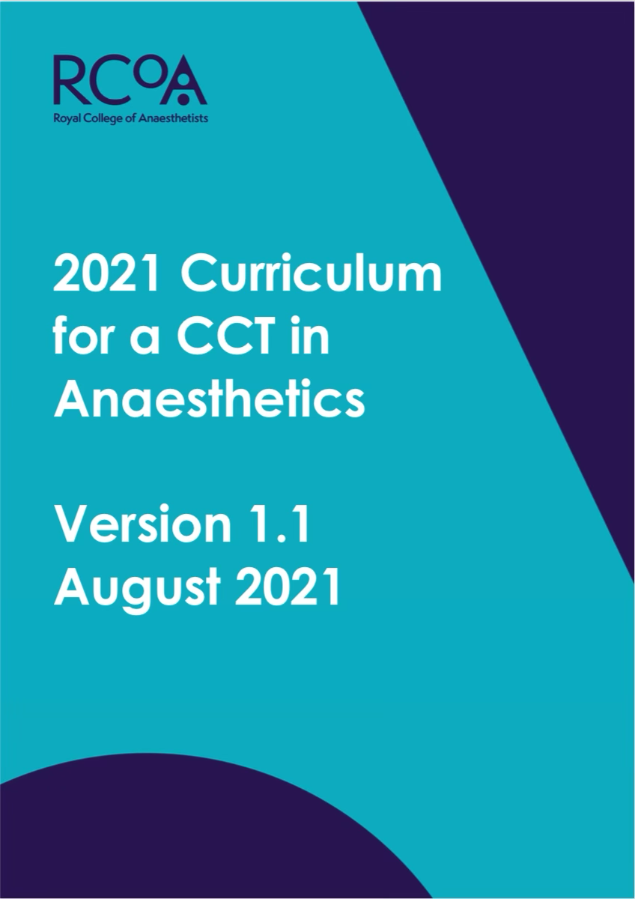
NAP8 - Background
Regional Anaesthesia (RA)
  Increase in use of RA techniques over last 10 years
  More prominent role in RCoA 2021 curriculum
  NAP7 - ∼14% of all non-obstetric anaesthetic procedures involved a peripheral nerve block

Slide 4
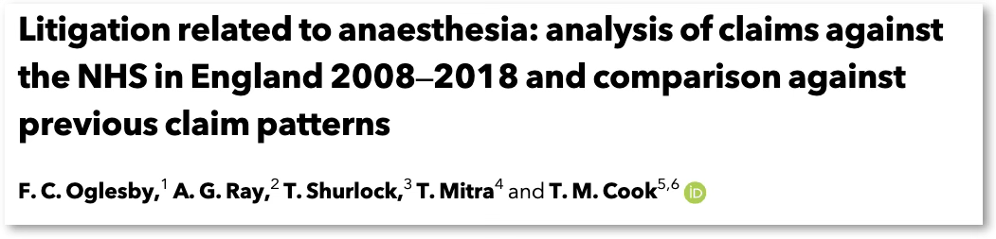

NAP8 - Background
Regional Anaesthesia (RA)
  RA is most common reason for NHS litigation in anaesthesia-related claims
      Claims due to peripheral nerve blocks have doubled in 10 years
  Need accurate data on risk, complications and harm to inform consent discussions

Slide 5

NAP8 - Background
Central Neuraxial Blocks (CNB)
  NAP3 - Major Complications of CNB - 2009
  NAP7 (2024) - Change in surgical population - older, frailer, more co-morbid
  Advent of DOACs - change in risk profile for RA techniques
  Need to re-evaluate risk and close NAP3 loop

Slide 6
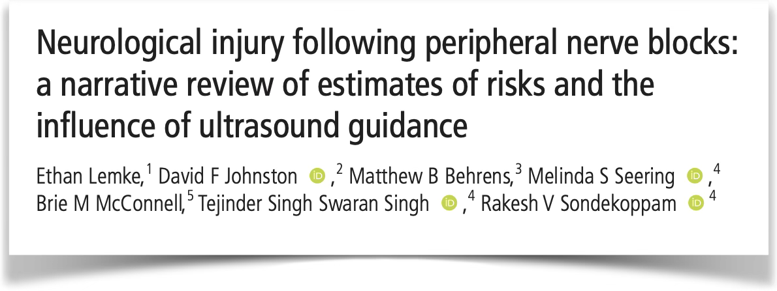
NAP8 - Background
Peripheral Nerve Blocks (PNB)
  Permanent nerve injury approximately 1 in 3000?
    Inadequate duration of follow up in some studies
    Inadequate investigation if definitely secondary to PNB

Slide 7
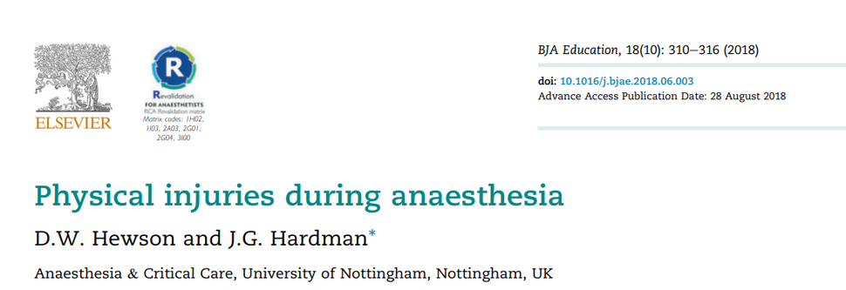
NAP8 - Background
Perioperative Nerve Injury
Unrelated to PNB or direct surgical injury – position/compression related
  Ulnar injury 1:215-385
  Peroneal injury 1:4600
  Brachial plexus injury 1:2000
Dated evidence/Under-reporting - incidence unclear

Slide 8
NAP8 - Background
Spinal Cord Injury
Unrelated to direct surgical injury
  Incidence - High risk cardiothoracic procedures ~1.5% ^{[7]}
  Unclear incidence in non-cardiovascular procedures - case report only
  Potentially devastating sequelae

Slide 9
NAP8 Scope

Slide 10
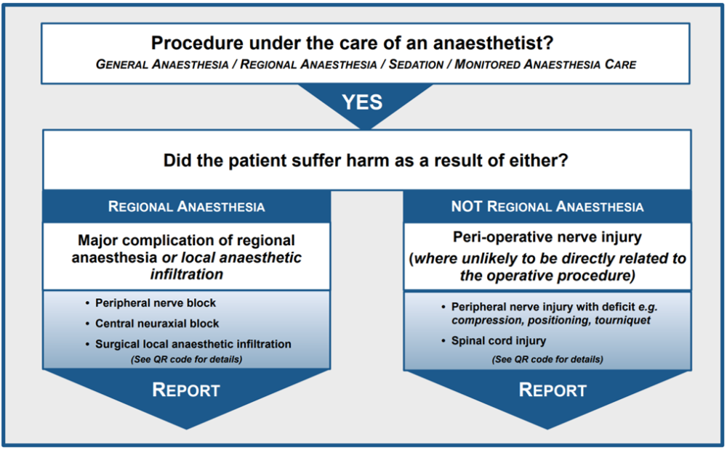
NAP8 Inclusion Criteria

Slide 11
NAP8 Inclusion Criteria
Under the care of an anaesthetist:
Any procedure conducted under general anaesthesia, regional anaesthesia/analgesia, local anaesthesia or monitored anaesthesia care with an anaesthetist or anaesthesia associate present
NHS and Independent Sector

Slide 12

NAP8 Inclusion Criteria
COMPLICATIONS - RA
EITHER PNB OR CNB
Wrong route drug error
Local anaesthetic systemic toxicity
Pneumothorax
Cardiac arrest due to PNB/CNB
Infection at PNB/CNB site
Anaphylaxis due to PNB/CNB
Visceral or other organ injury
If in doubt - REPORT

Slide 13
NAP8 Inclusion Criteria
COMPLICATIONS - RA
CNB ONLY
High/total/complete spinal
Respiratory failure
Vertebral canal haematoma
Vertebral canal abscess
Infective meningitis
Adhesive arachnoiditis
Nerve injury after CNB
Other
If in doubt - REPORT

Slide 14
NAP8 Inclusion Criteria
COMPLICATIONS - RA
PNB ONLY
Wrong site block
Phrenic nerve palsy
Haemorrhage
Peripheral nerve injury due to PNB
Other
If in doubt - REPORT
Notes:
Please point out here NAPs look for serious harm/major complications i.e. for phrenic nerve palsy it would need to be requiring invasive/non-invasive ventilation or a phrenic nerve palsy lasting >48hrs with associated functional impairment. Similarly for haemorrhage it needs to result in blood transfusion, interventional radiology or surgery.

Slide 15

NAP8 Inclusion Criteria
COMPLICATIONS - NOT RA RELATED
Spinal cord injury unrelated to direct surgical injury
Peripheral nerve injury unrelated to PNB/CNB/surgical injury
If in doubt - REPORT

Slide 16
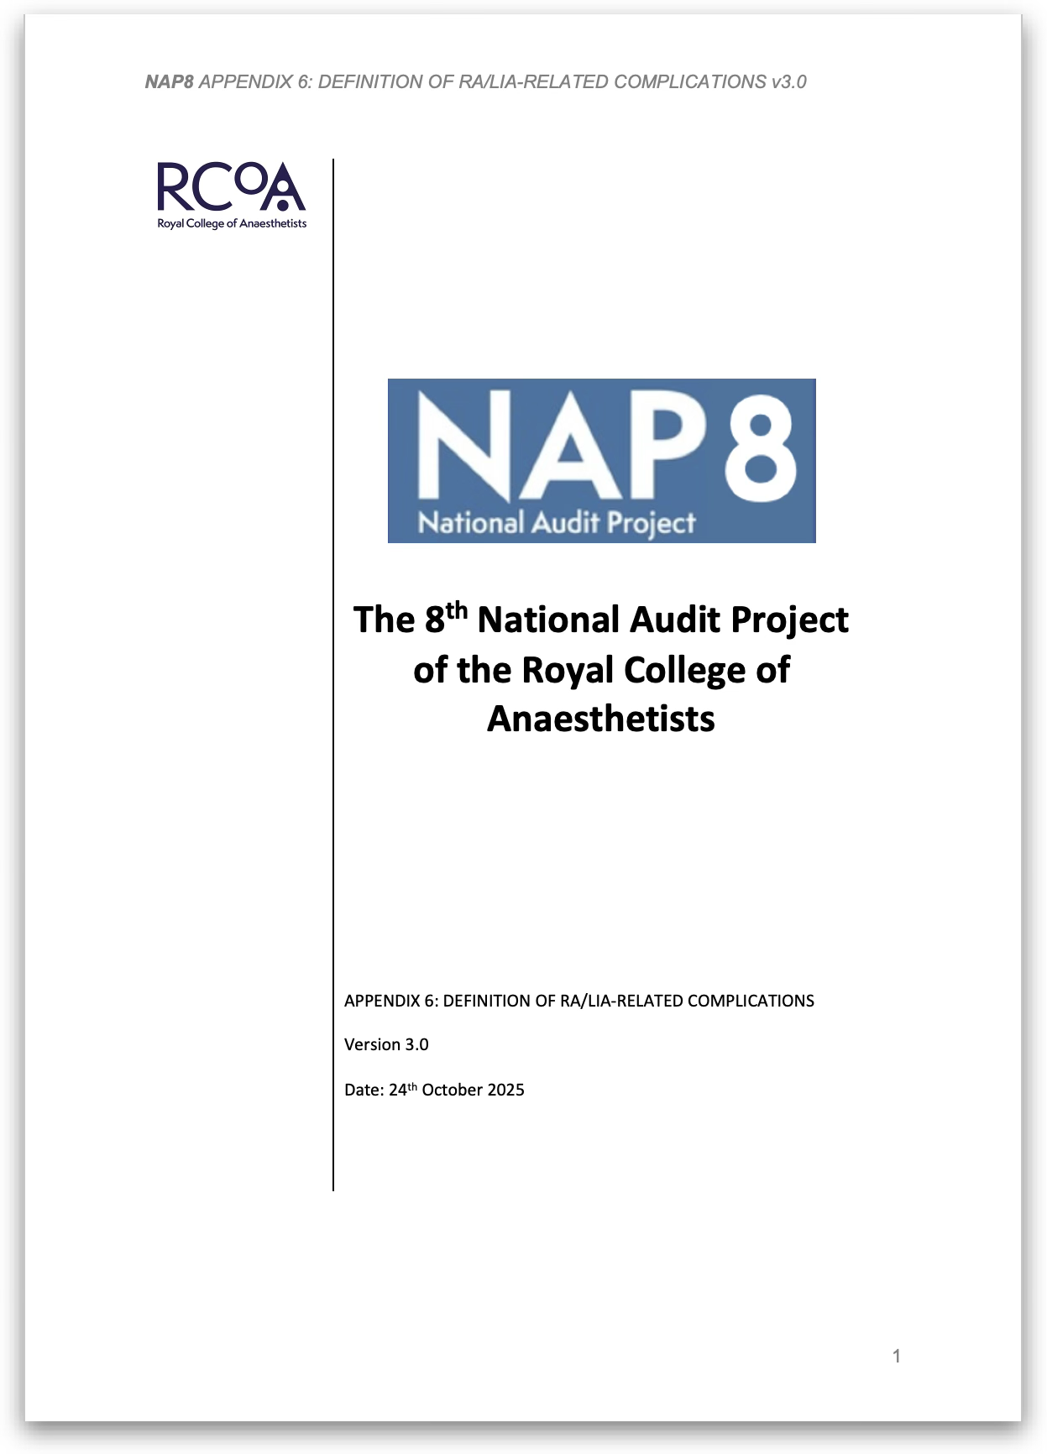
If in doubt - REPORT
Notes:
Encourage people to look through the complications document

Slide 17
NAP8 Exclusion Criteria
· Sedation or anaesthesia in critical care not involving regional anaesthesia
· Critical care procedures except for regional anaesthetic/analgesic procedures
· Intra or interhospital transfers
· Blocks performed by someone who is not either an anaesthetist or an anaesthesia associate e.g. emergency physicians

Slide 18



NAP8 - Structure
Baseline Surveys
Case Registry
Activity Survey
At the start of NAP8
Individual survey:
  All anaesthetists and anaesthesia associates
  Personal experience and current practice of regional anaesthesia
Local Coordinator Survey:
  Departmental structure and processes
Early 2026 for 20 months
Please report all cases that meet inclusion criteria to local coordinator
Complete case review form
All cases reviewed by NAP8
Panel
June 2026
7-day survey of all sites in UK and Republic of Ireland
Essential to estimate denominator data

Slide 19

NAP8 - Structure
Baseline Surveys
Case Registry
Activity Survey
At the start of NAP8
Individual surveys:
  All anaesthetists and anaesthesia associates
  Personal experience and current practice of regional anaesthesia
Local Coordinator Survey:
  Departmental structure and processes
Starting early 2026 for 18 months
Please report all cases that meet inclusion criteria to local coordinator
Complete case review form
All cases reviewed by NAP8
Panel
Mid 2026
7-day rotational survey of all sites in UK and Republic of Ireland
Essential to estimate denominator data
ALL REPORTING IS ANONYMOUS AND CONFIDENTIAL

Slide 20
Baseline Surveys
Individual Baseline Survey
10-15 minutes (SmartSurvey – smartphone quicker than a computer)
Link distributed by local coordinator (LC)
Certificates of completion available from LC with completion code
Local Coordinator Survey
One per site
Launched: 1st December 2025

Slide 21
Case Registry
One year case registry period
Additional 6 months after the one year to allow follow up of any nerve injuries Further 2 months for database entry
Report any case to local coordinator in first instance
LC will be promoting NAP8 amongst other specialties to forward eligible cases
NO ADDITIONAL FOLLOW-UP REQUIRED BEYOND USUAL PROCEDURE
Launch: Aiming March 2026
Notes:
Discuss peripheral nerve injury in particular which may present weeks post-discharge – physios, neurologists, neurosurgeons, peripheral nerve surgeons, all other surgeons may encounter these rather than us.

Slide 22
Activity Survey
7 consecutive day snapshot of anaesthetic activity in UK and ROI
Individual SmartSurvey form for each case
Completed by anaesthetist or anaesthesia associate
Launch: Aiming June 2026

Slide 23


Independent Sector
Potentially lots of orthopaedics and RA
Abbreviated activity survey - quicker to complete
If complication from Independent Sector presents to NHS please liase with Independent Sector anaesthetist to avoid double counting
Notes:
NAP8 team working with the IHPN and the Private Healthcare Information Network to increase engagement with Independent Sector and have two anaesthetists plus others representing these groups and the Independent Sector.

Slide 24
Associate Local Coordinator Scheme
For Residents, Specialty and Locally Employed Doctors
Hands-on role assisting LC with NAP delivery
Discuss with your LC for more information

Slide 25

Thank you for your time and for helping with NAP8!
Questions?

Slide 26
References
  Konijn, A. ∙ Aldecoa, C. ∙ Benhamou . Regional anaesthesia practices: insights from a European survey Eur J Anaesth Int Care. 2023; 2, e0026
  Gabriel, R.A. ∙ Ilfeld, B.M. Use of regional anesthesia for outpatient surgery within the United States: a prevalence study using a nationwide database Anesth Analg. 2018; 126:2078-2084
  Patient characteristics, anaesthetic workload and techniques in the UK: an analysis from the 7th National Audit Project (NAP7) activity survey. Anaesthesia. 2023; 78:701-711
  Oglesby, F.C. ∙ Ray, A.G. ∙ Shurlock, T. et al. Litigation related to anaesthesia: analysis of claims against the NHS in England 2008–2018 and comparison against previous claim patterns. Anaesthesia. 2022; 77:527-537
  Lewis, O. ∙ Lloyd, J. ∙ Ferry, J. et al. Regional anaesthesia research priorities: a Regional Anaesthesia UK (RA-UK) priority setting partnership involving patients, carers and healthcare professionals. Anaesthesia. 2025; 80:170-178
  Major complications of central neuraxial block: report on the Third National Audit Project of the Royal College of Anaesthetists. Br J Anaesth. 2009; 102:179-190
  Pandit, J.J. ∙ Andrade, J. ∙ Bogod, D.G. et al. 5th National Audit Project (NAP5) on accidental awareness during general anaesthesia: summary of main findings and risk factors. Br J Anaesth. 2014; 113:549-559

