Slide 1
A straightforward case of MUA in a 9 year old girl? Dr Hilary Glaisyer July 2017

Slide 2
The setting
Rebecca is a 9 year old girl.
She presents to you for a day case manipulation under anaesthesia of a fractured wrist.
She is with her mother.
She fell the previous day from a climbing frame in the local park.
You notice a burn on her leg as you examine her and ask what happened. The mother says she fell over the iron as it was warming up. The practice nurse has been dressing the burn and is pleased with its progress.

Slide 3
Once Rebecca is anaesthetised you notice bruising on her arm and as you insert the laryngeal mask you see some bruising over the left ear.
During the case you discuss these findings with the orthopaedic SpR who is not overly concerned and thinks the iron burn explanation plausible
However the whole picture makes you CONSIDER a safeguarding issue and you decide to speak with the named paediatrician.
The paediatrician asks you to tell Rebecca and her mother that you are concerned about these three injuries occurring in such a short space of time and would like them to meet a paediatrician with you who will be able to offer a second opinion

Slide 4
Key Questions
What are your responsibilities and duties?
What will you do next?
What is likely to happen to Rebecca?

Slide 5
Learning Points
What are the things that lead you to be concerned?
More than one injury, one explained (#arm) one an unconvincing partial explanation (burn) one not explained (hairline haematoma)
Bruises in the head and neck area are relatively unusual and maybe of concern in any age child but particularly babies that are not mobile

Slide 6
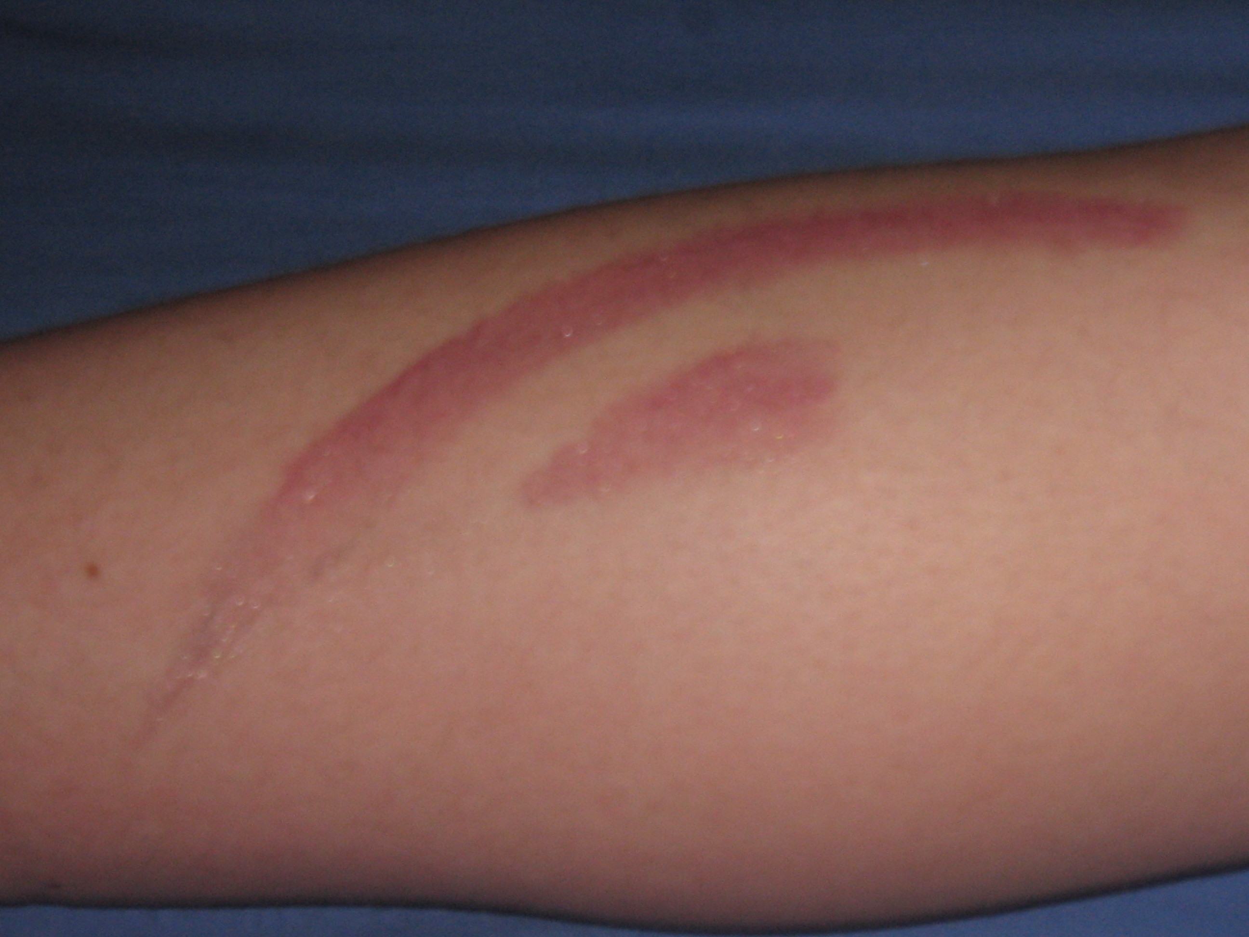
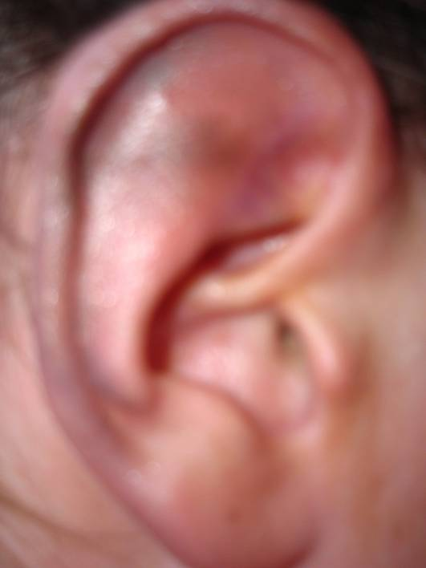
Learning Points
Fig 1. Photo of burn on Rebecca’s leg
Fig 2. Photo of bruise on Rebecca’s ear

Slide 7
Learning Points
What action must you take?
You must document the facts (not opinion) and draw a body map in the patient’s notes.
You should not take photographs or unnecessarily prolong the anaesthetic.
You must contact a paediatrician or safeguarding professional e.g. the named nurse or doctor and discuss the case with them, with a view to making a referral to them.
The paediatrician is likely to plan a meeting with Rebecca and her mother after she has recovered from the GA and before discharge home. You may be involved in the meeting or will have spoken to Rebecca and her mother to explain why you have asked the paediatrician to be involved and for their opinion.

Slide 8
Learning Points
During the meeting with the paediatrician, Rebecca and her mother, at which you are present, a story unfolds of a new partner who drinks and is aggressive and violent to the children while Rebecca’s mother is at work and he has sole care.
The burn occurred when Rebecca accidently jogged him when he was preparing to iron a shirt and he pushed her away with the iron that was warming up.
The mother was not aware of this and had believed the story that Rebecca had fallen onto the iron.

Slide 9
Learning Points
The bruising on the scalp was caused when the TV remote was thrown at Rebecca when she interrupted the football.
The broken arm had resulted from a fall from a climbing frame.
The paediatrician and Rebecca’s mother agree that Rebecca will stay overnight. A referral is made to the Social Care team and a strategy meeting is planned. The other children will stay at Grandma’s and the police will interview the Mother’s partner.

Slide 10
Key points
The safety of the child is paramount and overrides all other duties
You must act in the best interest of the child and act on your concerns.
You must be aware of and protect the child’s rights including their right to confidentiality.
You must contact and refer to a paediatrician or local safeguarding team.
You must document your findings.
You should seek to follow up your referral to the Safeguarding team and satisfy yourself that appropriate action was taken.

Slide 11
References
Protecting children in theatre – a new resource for anaesthetists RCoA September 2016: https://youtu.be/JpxXd6C1YrE
Child Protection and the Anaesthetist – Safeguarding in the Operating Theatre RCoA July 2014 http://www.rcoa.ac.uk/system/files/CHILD-PROTECTION-2014.pdf
Protecting Children and Young People –The responsibilities of all doctors GMC 2012 http://www.gmc-uk.org/Protecting_children_and_young_people___English_1015.pdf_48978248.pdf

Slide 12
See also www.rcoa.ac.uk/safeguardingplus

